Slide 1
International perspectives on ICD-11 prolonged grief disorder
Professor Mark Shevlin and Professor Philip Hyland

Slide 2
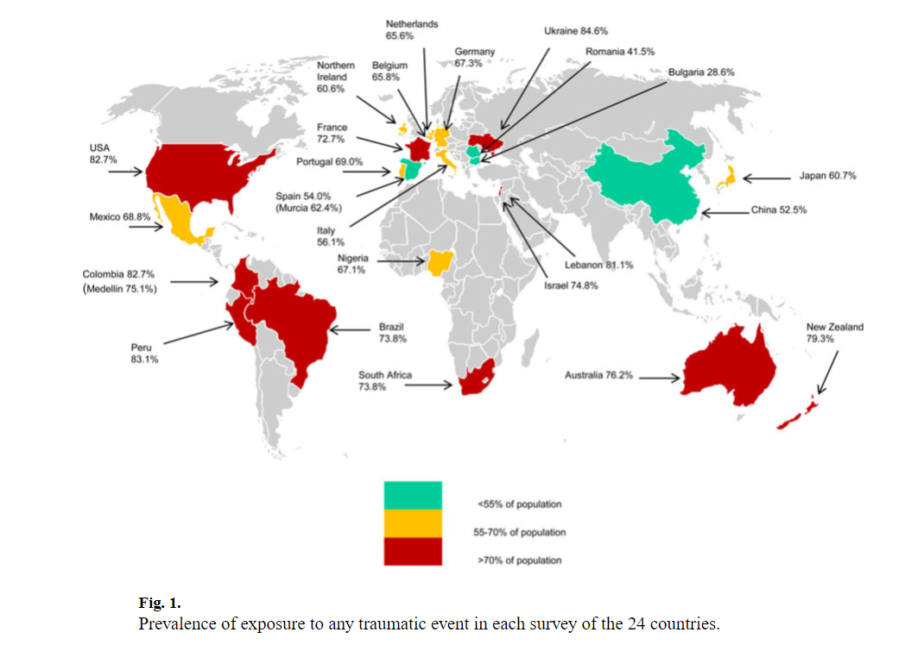
Exposure to Trauma and Stressful Events is not Rare…
Notes:
In this talk, we want to take you on a journey of how we got to where we are today with ICD-11 PTSD and CPTSD, and where we are going in the future.

Slide 3
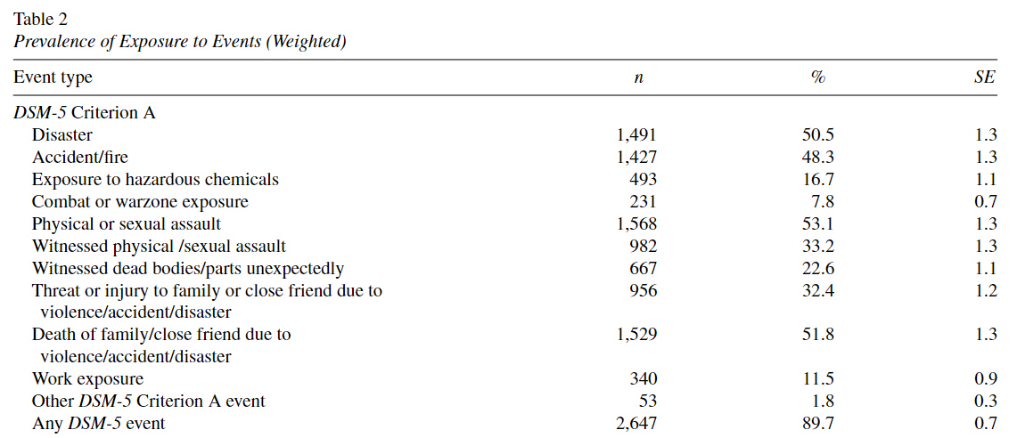
Exposure to Trauma and Stressful Events is not Rare, but Varies by Type…
Notes:
In this talk, we want to take you on a journey of how we got to where we are today with ICD-11 PTSD and CPTSD, and where we are going in the future.

Slide 4
Exposure to Trauma and Stressful Events is not Rare, but Varies by Type…
Notes:
In this talk, we want to take you on a journey of how we got to where we are today with ICD-11 PTSD and CPTSD, and where we are going in the future.

Slide 5
Exposure to Trauma and Stressful Events is not Rare, but Varies by Type…
Notes:
In this talk, we want to take you on a journey of how we got to where we are today with ICD-11 PTSD and CPTSD, and where we are going in the future.

Slide 6
Exposure to Trauma and Stressful Events is not Rare, but it Varies by Type…
Notes:
In this talk, we want to take you on a journey of how we got to where we are today with ICD-11 PTSD and CPTSD, and where we are going in the future.

Slide 7
Exposure to Trauma and Stressful Events is not Rare, but Varies by Type…
Notes:
In this talk, we want to take you on a journey of how we got to where we are today with ICD-11 PTSD and CPTSD, and where we are going in the future.

Slide 8
Exposure to Trauma and Stressful Events is not Rare, but Varies by Type (and some are almost inevitable)…
The loss of a loved one does not need to be sudden, violent or unexpected to be emotionally painful.
Notes:
In this talk, we want to take you on a journey of how we got to where we are today with ICD-11 PTSD and CPTSD, and where we are going in the future.

Slide 9
Problematic Grief Has Been Acknowledged…
Anticipatory Grief
Complicated Grief
Chronic Grief
Delayed Grief
Distorted Grief
Cumulative Grief
Exaggerated Grief
Secondary Loss
Masked Grief
Disenfranchised Grief (Ambiguous)
Traumatic Grief
Collective Grief
Inhibited Grief
Abbreviated Grief
Absent Grief

Slide 10
Problematic Grief Has Been Acknowledged…
Notes:
In this talk, we want to take you on a journey of how we got to where we are today with ICD-11 PTSD and CPTSD, and where we are going in the future.

Slide 11
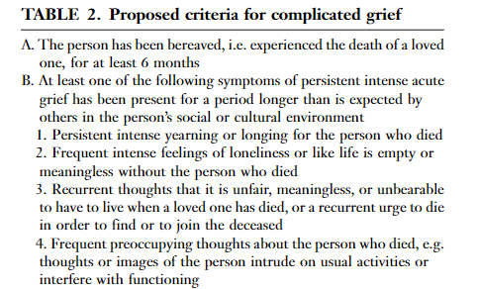
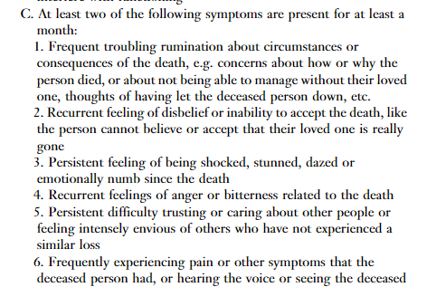
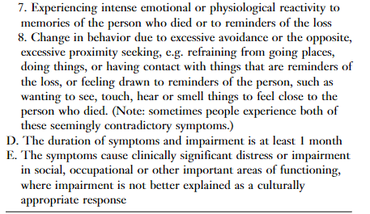
Problematic Grief Has Been Acknowledged…
Notes:
In this talk, we want to take you on a journey of how we got to where we are today with ICD-11 PTSD and CPTSD, and where we are going in the future.

Slide 12
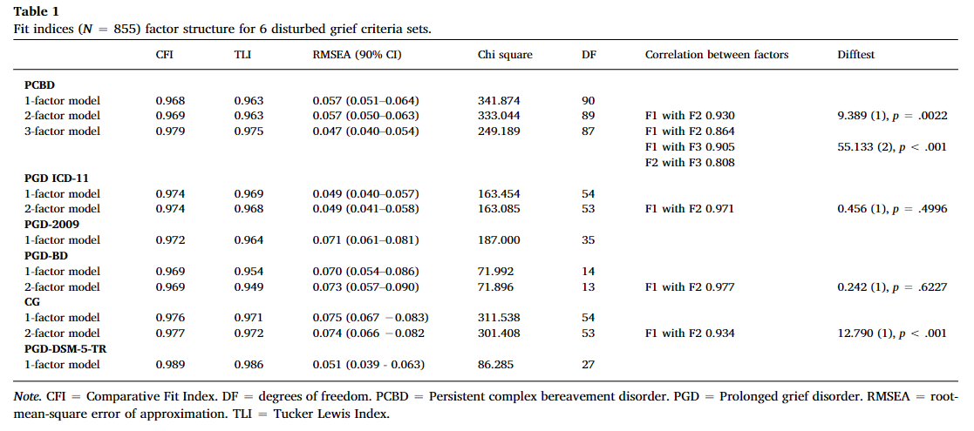
Problematic Grief Has Been Acknowledged…
Notes:
In this talk, we want to take you on a journey of how we got to where we are today with ICD-11 PTSD and CPTSD, and where we are going in the future.

Slide 13
Problematic Grief is….
Notes:
In this talk, we want to take you on a journey of how we got to where we are today with ICD-11 PTSD and CPTSD, and where we are going in the future.

Slide 14
Problematic Grief is….
What the ICD-11 says it is…
Notes:
In this talk, we want to take you on a journey of how we got to where we are today with ICD-11 PTSD and CPTSD, and where we are going in the future.

Slide 15
Problematic Grief is….
What the ICD-11 says it is…
Core Symptoms
Associated Symptoms
Notes:
In this talk, we want to take you on a journey of how we got to where we are today with ICD-11 PTSD and CPTSD, and where we are going in the future.

Slide 16
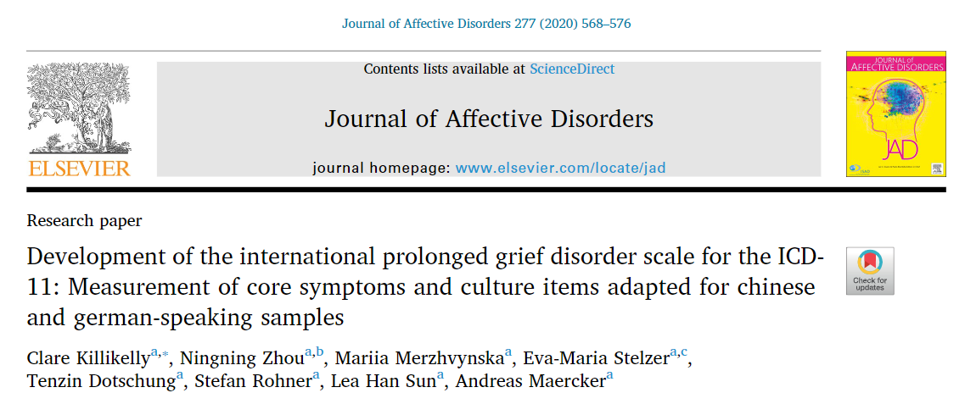
How to Measure ICD-11 PGD?
Notes:
In this talk, we want to take you on a journey of how we got to where we are today with ICD-11 PTSD and CPTSD, and where we are going in the future.

Slide 17
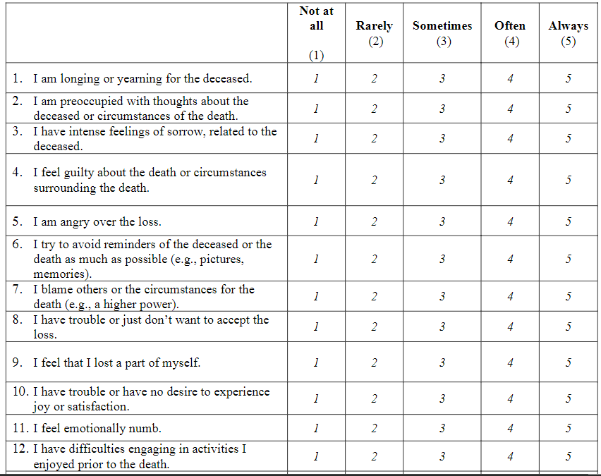
How to Measure ICD-11 PGD?
Notes:
In this talk, we want to take you on a journey of how we got to where we are today with ICD-11 PTSD and CPTSD, and where we are going in the future.

Slide 18
How to Measure ICD-11 PGD?
The IPGDS represents a ‘model’ of PGD – an approximation,
a simplification, something that takes the essence of an object
or person.
Notes:
In this talk, we want to take you on a journey of how we got to where we are today with ICD-11 PTSD and CPTSD, and where we are going in the future.

Slide 19
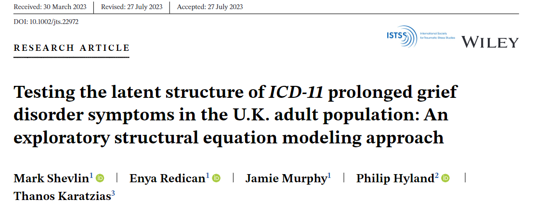
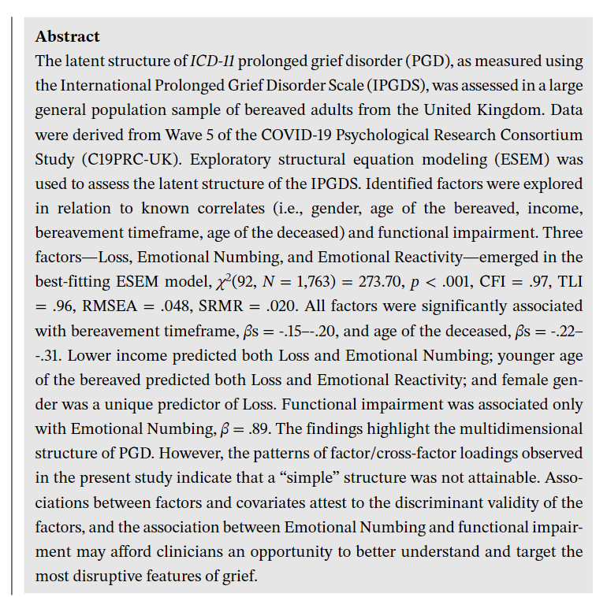
How to Measure ICD-11 PGD?
Notes:
In this talk, we want to take you on a journey of how we got to where we are today with ICD-11 PTSD and CPTSD, and where we are going in the future.

Slide 20
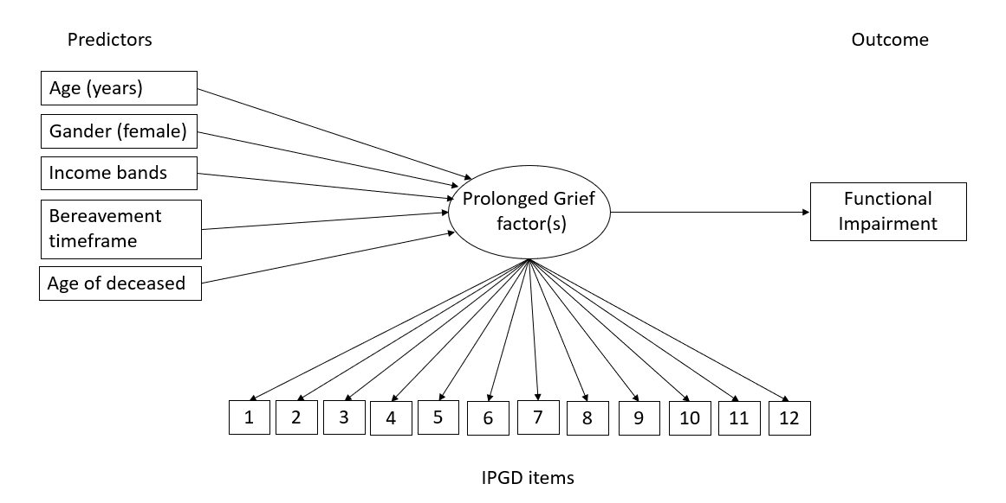
How to Measure ICD-11 PGD?
Notes:
In this talk, we want to take you on a journey of how we got to where we are today with ICD-11 PTSD and CPTSD, and where we are going in the future.

Slide 21
How to Measure ICD-11 PGD?
Notes:
In this talk, we want to take you on a journey of how we got to where we are today with ICD-11 PTSD and CPTSD, and where we are going in the future.

Slide 22
How to Measure ICD-11 PGD?
Core
Notes:
In this talk, we want to take you on a journey of how we got to where we are today with ICD-11 PTSD and CPTSD, and where we are going in the future.

Slide 23
How to Measure ICD-11 PGD?
Notes:
In this talk, we want to take you on a journey of how we got to where we are today with ICD-11 PTSD and CPTSD, and where we are going in the future.

Slide 24
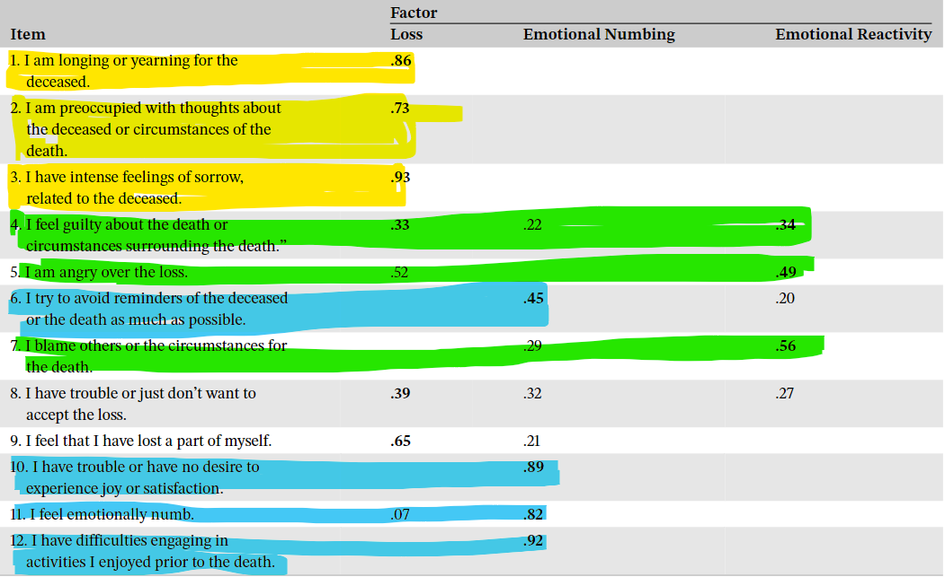
How to Measure ICD-11 PGD?
Notes:
In this talk, we want to take you on a journey of how we got to where we are today with ICD-11 PTSD and CPTSD, and where we are going in the future.

Slide 25
A New Model of ICD-11 PGD?
Our premise: The ICD-11states that PGD is “characterized by longing for the deceased or persistent preoccupation with the deceased”, delineating these as the principal symptoms of the disorder; there is also a requirement that these problems are “accompanied by intense emotional pain.” Taken together, this implies that interindividual differences in the severity of PGD should be primarily due to longing and preoccupation and, to a lesser extent, the associated problems.
Notes:
In this talk, we want to take you on a journey of how we got to where we are today with ICD-11 PTSD and CPTSD, and where we are going in the future.

Slide 26
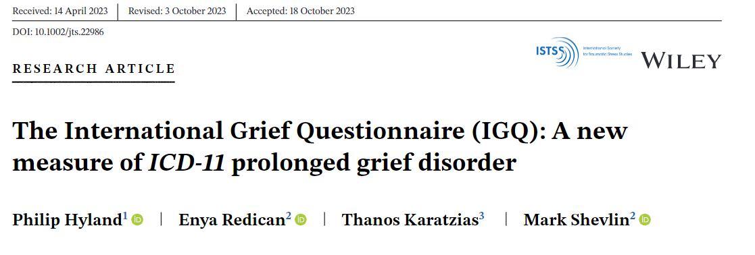
A New Model of ICD-11 PGD?
Notes:
In this talk, we want to take you on a journey of how we got to where we are today with ICD-11 PTSD and CPTSD, and where we are going in the future.

Slide 27
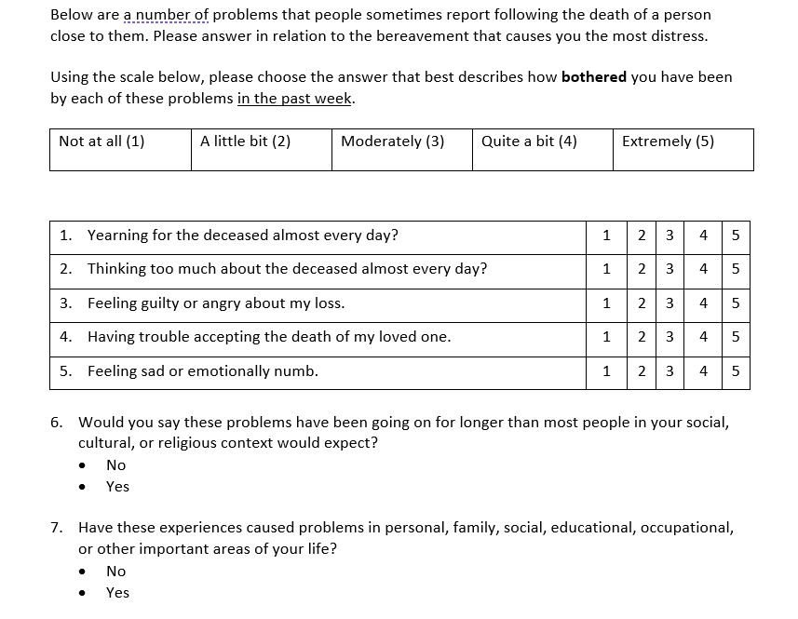
A New Model of ICD-11 PGD?
Notes:
In this talk, we want to take you on a journey of how we got to where we are today with ICD-11 PTSD and CPTSD, and where we are going in the future.

Slide 28
A New Model of ICD-11 PGD?
Notes:
In this talk, we want to take you on a journey of how we got to where we are today with ICD-11 PTSD and CPTSD, and where we are going in the future.

Slide 29
A New Model of ICD-11 PGD?
Notes:
In this talk, we want to take you on a journey of how we got to where we are today with ICD-11 PTSD and CPTSD, and where we are going in the future.

Slide 30
A New Model of ICD-11 PGD?
Notes:
In this talk, we want to take you on a journey of how we got to where we are today with ICD-11 PTSD and CPTSD, and where we are going in the future.

Slide 31
A New Model of ICD-11 PGD?
Notes:
In this talk, we want to take you on a journey of how we got to where we are today with ICD-11 PTSD and CPTSD, and where we are going in the future.

Slide 32
A New Model of ICD-11 PGD?
Notes:
In this talk, we want to take you on a journey of how we got to where we are today with ICD-11 PTSD and CPTSD, and where we are going in the future.

Slide 33
A New Model of ICD-11 PGD?
Notes:
In this talk, we want to take you on a journey of how we got to where we are today with ICD-11 PTSD and CPTSD, and where we are going in the future.

Slide 34
A New Model of ICD-11 PGD?
Notes:
In this talk, we want to take you on a journey of how we got to where we are today with ICD-11 PTSD and CPTSD, and where we are going in the future.

Slide 35
A New Model of ICD-11 PGD?
Notes:
In this talk, we want to take you on a journey of how we got to where we are today with ICD-11 PTSD and CPTSD, and where we are going in the future.

Slide 36
A New Model of ICD-11 PGD?
Notes:
In this talk, we want to take you on a journey of how we got to where we are today with ICD-11 PTSD and CPTSD, and where we are going in the future.

Slide 37
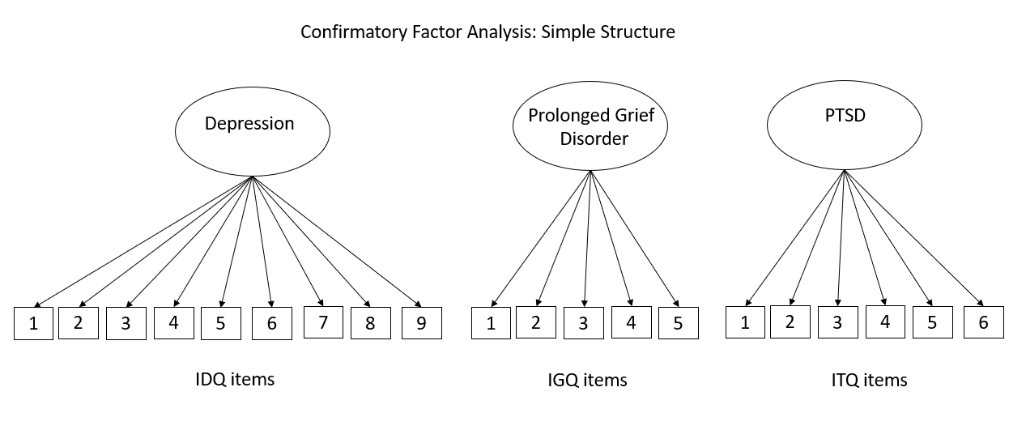
A New Model of ICD-11 PGD: Distinct?
Notes:
In this talk, we want to take you on a journey of how we got to where we are today with ICD-11 PTSD and CPTSD, and where we are going in the future.

Slide 38
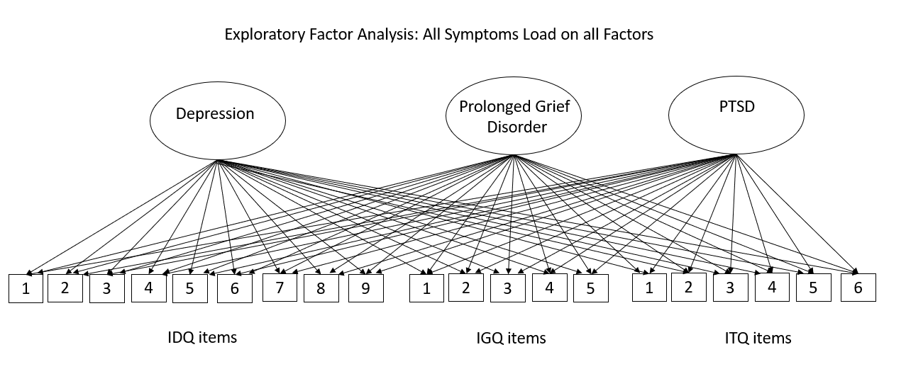
A New Model of ICD-11 PGD: Distinct?
Notes:
In this talk, we want to take you on a journey of how we got to where we are today with ICD-11 PTSD and CPTSD, and where we are going in the future.

Slide 39
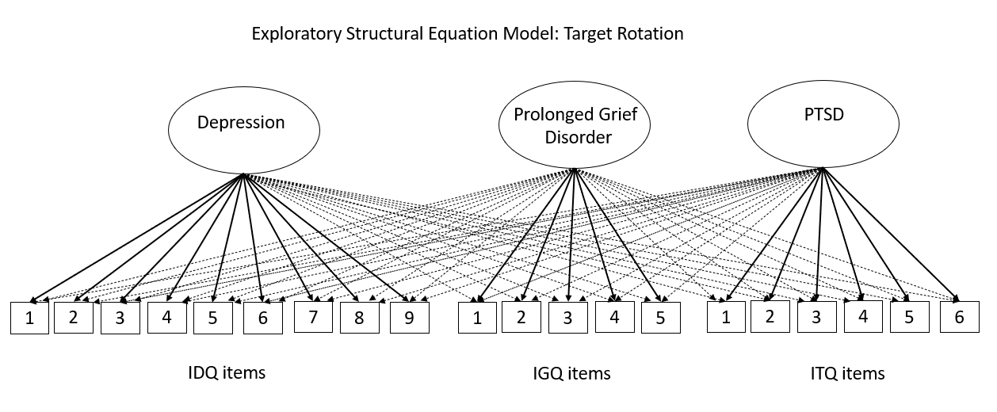
A New Model of ICD-11 PGD: Distinct?
Notes:
In this talk, we want to take you on a journey of how we got to where we are today with ICD-11 PTSD and CPTSD, and where we are going in the future.

Slide 40
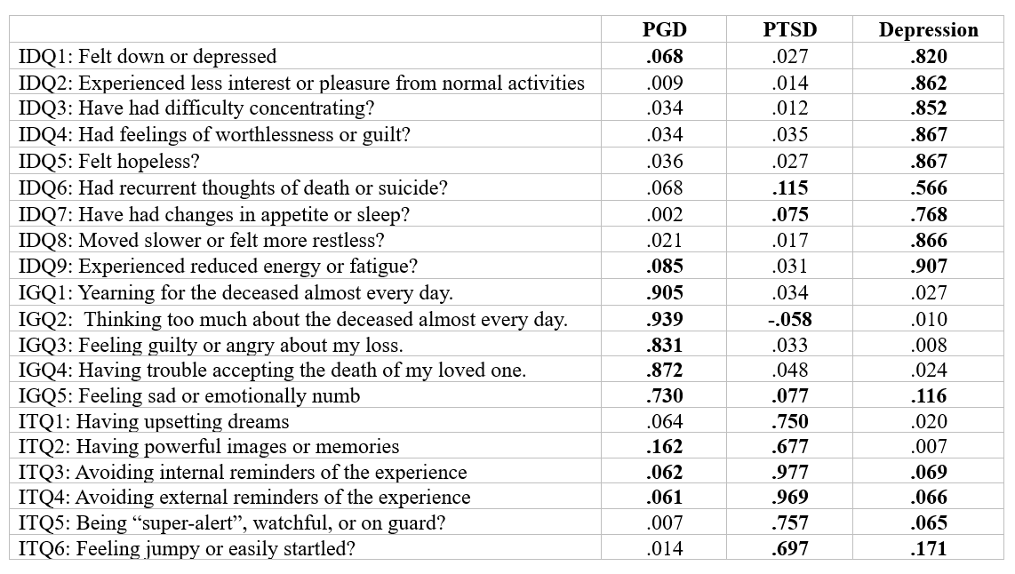
A New Model of ICD-11 PGD: Distinct?
Factor Loadings from Exploratory Structural Equation Model
Notes:
In this talk, we want to take you on a journey of how we got to where we are today with ICD-11 PTSD and CPTSD, and where we are going in the future.

Slide 41
Using the IGQ

Slide 42
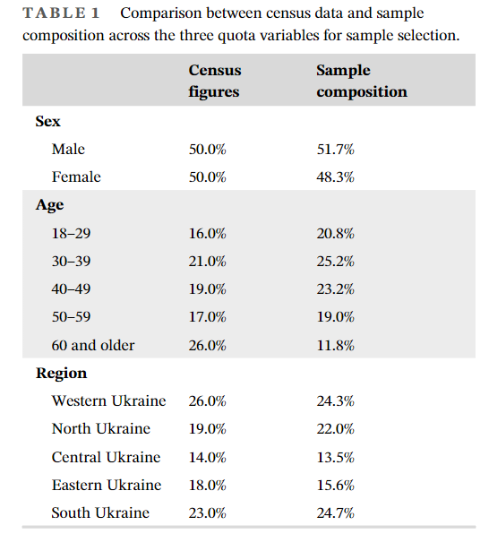
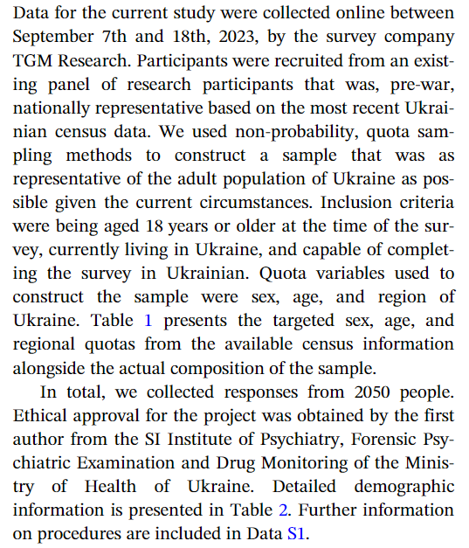
Using the IGQ

Slide 43
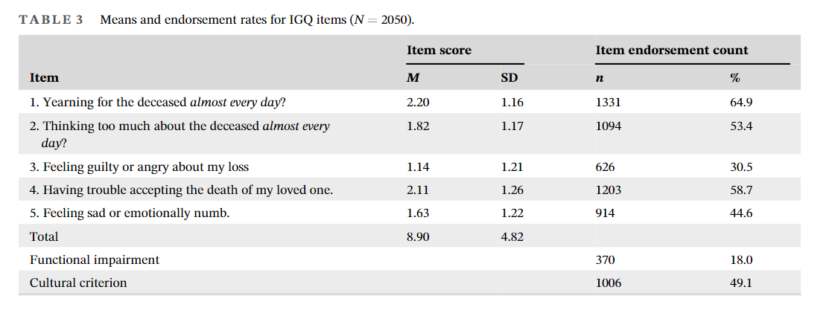
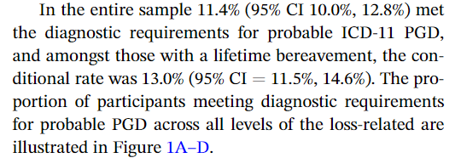
Using the IGQ

Slide 44
Using the IGQ

Slide 45
Using the IGQ

Slide 46
Using the IGQ

Slide 47
Using the IGQ

Slide 48
Conclusion
Prolonged Grief Disorder (PGD) is a new ICD-11 disorder
Yearning and preoccupation are the core distinguishing symptoms
The International Grief Questionnaire assesses these symptoms
PGD is a distinct symptom set from PTSD and depression
Future research should examine the co-occurrence of PDG and other disorders (and specificity of risk factors)
Are the complex, complicated and traumatic grief concepts finished?

Slide 49
Thanks – Questions?

