Slide 1
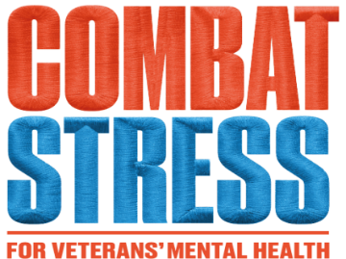
Enhanced Skills Training in Affective and Interpersonal Regulation (ESTAIR): An Innovative Person-Centred Approach to Treating Complex PTSD (CPTSD)
Prof. Thanos Karatzias
Edinburgh Napier University &
Incoming Editor in Chief of Traumatology

Slide 2
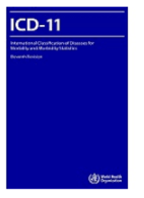
ICD-11 PTSD and Complex PTSD
“Gate” Criterion: Traumatic Stressor
PTSD | CPTSD
Re-experiencing | Re-experiencing
Avoidance | Avoidance
Sense of Threat | Sense of Threat
 | Affect Dysregulation
 | Negative Self Concept
 | Disturbed Relationships
Functional Impairment | Functional Impairment
Diagnosis is either PTSD or CPTSD: If PTSD and DSO criteria met = CPTSD
Type of trauma is a risk factor not a requirement for a diagnosis

Slide 3
CPTSD Treatment: Where are we?
ICD-11 Complex PTSD (CPTSD) is a relatively new condition and there is very limited evidence for its treatment.
There is a substantial evidence base on the treatment of PTSD.

Slide 4
Metanalysis of Group Therapies for Complex Interpersonal Trauma
Phased 1 interventions can be useful for symptoms of general distress (e.g. anxiety and depression).
Phased 2 (Trauma Focused) interventions are required for traumatic stress.
Mahoney, Karatzias, Hutton (2019). Journal of Affective Disorders

Slide 5
Pilot RCT of Phase 1 Interventions
N = 86 female prisoners with interpersonal trauma.
10 sessions of Phase 1 (group psychoeducation) vs. standard care.
Group psychoeducation achieved only small effect sizes in comparison to usual care across all outcomes including behavioural problems, emotional regulation and psychopathology.
Mahoney, Karatzias et al. (2020). Clinical Psychology & Psychotherapy

Slide 6
PTSD treatment EMDR vs. TfCBT vs. WL
Power et al… Karatzias (2002) Clinical Psychology and Psychotherapy
Karatzias et al. (2007) European Archives of Psychiatry and Clinical Neuroscience
Karatzias et al. (2011) Journal of Nervous and Mental Disease

Slide 7
Are existing therapies effective for CPTSD?

Slide 8
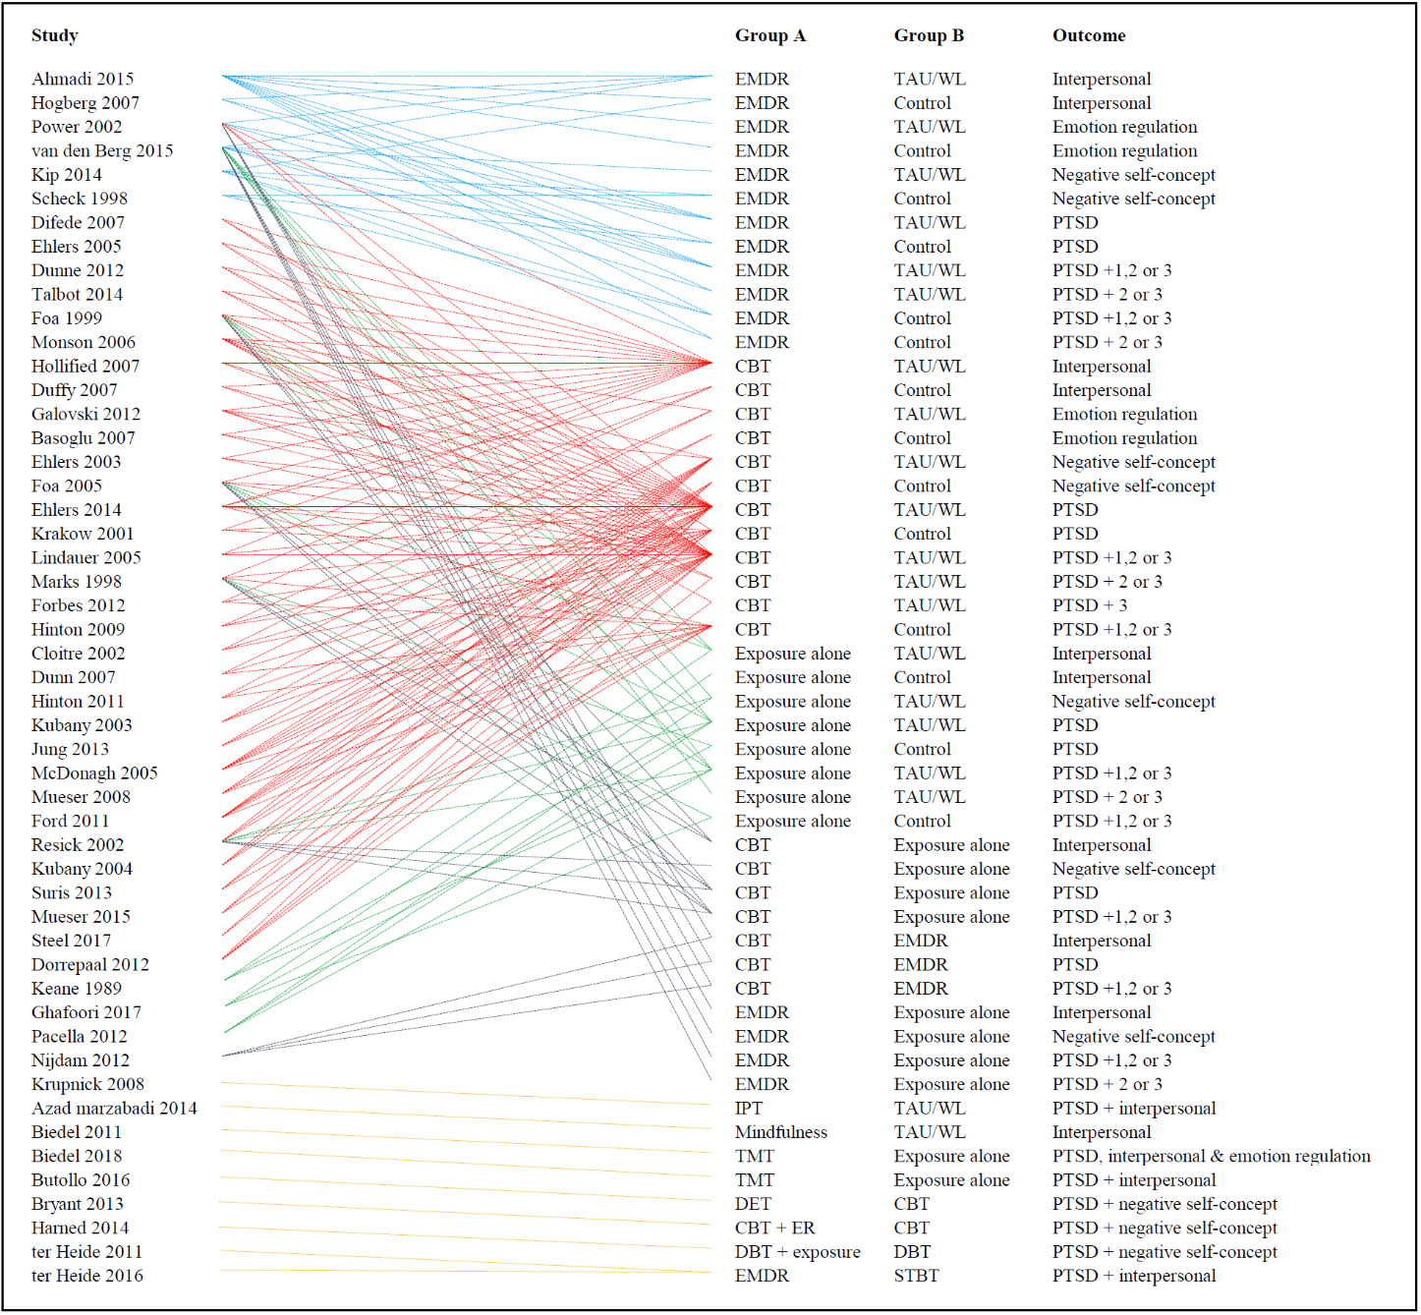
Metanalysis of existing therapies for CPTSD
Karatzias et al. (2019) Psychological Medicine

Slide 9
What do we know about the treatment of CPTSD?

Slide 10
Metanalysis of psychological and pharmacological interventions for PTSD following complex trauma
Multicomponent interventions that include skills-based strategies along with trauma-focused strategies are the most promising interventions for emotional dysregulation and interpersonal problems in people with complex trauma.
Multicomponent interventions that include cognitive restructuring and imaginal exposure are the most effective for reducing PTSD symptoms.
Coventry, Meader, Melton, Temple, Dale, Wright, Cloitre, Karatzias et al. (2020). PLOS Medicine

Slide 11
Modular therapy for CPTSD: A person centered approach
A thorough assessment of the patient’s presenting problems resulting in a case formulation about the underlying causes.
Therapist and patient decide on specific CPTSD clusters to target based on preference, readiness and severity using appropriate evidence based interventions.
At the end of delivery of this module, an assessment is conducted and the next therapeutic target is selected.
Karatzias & Cloitre (2020). Journal of Traumatic Stress

Slide 12
A new modular treatment protocol for CPTSD
Enhanced STAIR (ESTAIR) Narrative Therapy for CPTSD
25 sessions: 6 sessions per cluster (Self-concept, affect regulation, interpersonal relationships, PTSD) + a formulation session prior to start of treatment.
Cloitre, Karatzias, McGlanachy (2023) Brain Sciences

Slide 13
ESTAIR: Resource Loss Model of Trauma
Traumatic stress is an experience of resource loss:
Social resources: sense of connection to others
Emotional resources: ability to manage emotions
Identity: loss of mastery, competency, “goodness”
Cloitre, Karatzias, McGlanachy (2023) Brain Sciences

Slide 14
ESTAIR Modules
Affect Dysregulation (AD) : Emotion management, distress tolerance, and acceptance of feelings and experiencing positive emotions.
Negative Self-Concept (NSC) : The impact of trauma on one’s self concept, how to stay in the present moment and combat dissociation, compassion and mindfulness skills.
Disturbed Relationships (DR) : Effective assertiveness, awareness of social context, and flexibility in interpersonal expectations and behaviours that are displayed in social interactions.
Narrative Exposure (NE): Mild re-experiencing of the most distressing memory whilst eliciting and altering negative thoughts that are associated with traumatic events.

Slide 15
The RESTORE pilot trial
n=56 eligible veterans with CPTSD were randomised to either ESTAIR (n=28) or Treatment as Usual (TAU, n=28).
TAU: assessment and psychoeducation.
Karatzias et al. (2024). Psychotherapy & Psychosomatics

Slide 16
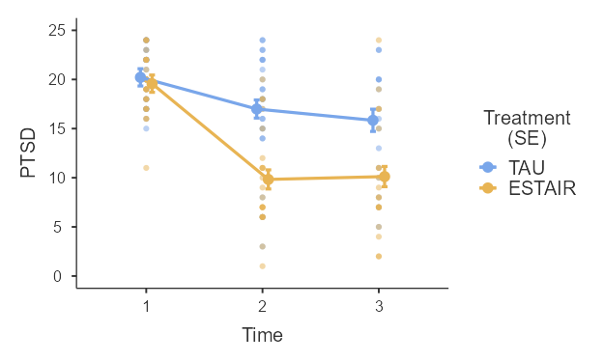
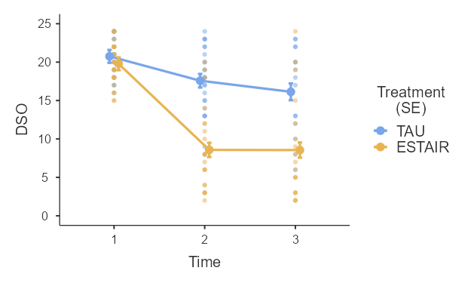
RESTORE: CPTSD scores at end of treatment and 3-month follow-up
Fig. 2. Pre, post-treatment and follow-up mean plot of PTSD and DSO scores
Karatzias et al. (2024). Psychotherapy & Psychosomatics

Slide 17
RESTORE: Key findings
Treatment dropout in ESTAIR and TAU was low and equivalent (18% vs. 11%; χ² (1) = 1.19, p = .275).
No serious adverse effects and very few adverse effects occurred, none of which were deemed related to the study.
ESTAIR provided significantly greater reduction in CPTSD severity across time for ITQ PTSD (p < .001) and DSO (p < .001) symptoms.
For comorbid symptoms of anxiety and depression greater improvement was observed in the ESTAIR group. No effect on alcohol use was observed.
CPTSD pre-to-post effect sizes for ESTAIR were large (PTSD d = 1.26; DSO d = 1.42).
Remission of probable CPTSD diagnosis at post-treatment was substantially greater in ESTAIR compared to TAU with only 18.2% versus 84% (p < .001) retaining the diagnosis.
Karatzias et al. (2024). Psychotherapy & Psychosomatics

Slide 18
Mean PTSD and DSO scores by module

Slide 19
Complex PTSD Pilot in Japan STAIR Narrative Therapy (Niwa et al., 2022)

Slide 20
Inpatient multicomponent therapy with PE and EMDR
Highly traumatised sample with severe dissociation (n=97) in Germany.
Eclectic and Multicomponent Therapy included group therapy, art therapy and EMDR or PE for memory processing (average treatment duration was 84 days).
Treatment effects were significant and large (g = .91 – 1.05). There was a significant main effect of reprocessing by time interaction (B = -17.2 [-30.5; -3.8], p = .012), indicating better outcomes with higher levels of reprocessing.
Kratzer…Karatzias et al. (2023). Journal of Nervous and Mental Disease

Slide 21
Conclusions & directions for future research
Modular / multicomponent therapies can be useful for the treatment of CPTSD and comorbidities (depression and anxiety).
RESTORE 2.
Testing the effectiveness, efficiency and cost-effectiveness of ESTAIR in community samples.
Testing the effectiveness of ESTAIR against other established trauma treatments for CPTSD (i.e. TfCBT, EMDR).

Slide 22
With thanks to all our participants and Forces in Mind Trust who funded this work!

Slide 23
Thank you for attending

