Slide 1


Assessment and Treatment of PTSD
in People with Severe or Moderate ID
Annemieke Hoogstad
a.hoogstad@amerpoort.nl

Slide 2



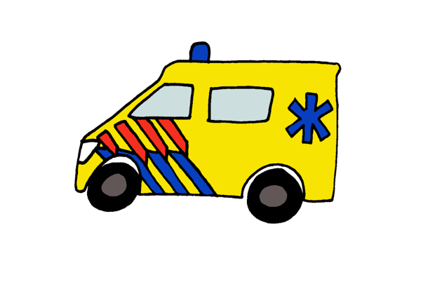
Post-Traumatic
Stress Disorder
5-10% PTSD
52%-81%

Slide 3






Post-Traumatic
Stress Disorder (PTSD)

Slide 4

PTSD & ID

Slide 5

Severe/ Moderate ID (SMID)
IQ 20-49
Cognitive developmental age 3-6 years
Depend on others (residential care)

Slide 6


Recognizing PTSD SMID
- DSM-5 < 6Y
- behaviour
- Less emphasis on cognitions
CB?

Slide 7



Pilot study
Evaluation of a trauma-interview

Slide 8
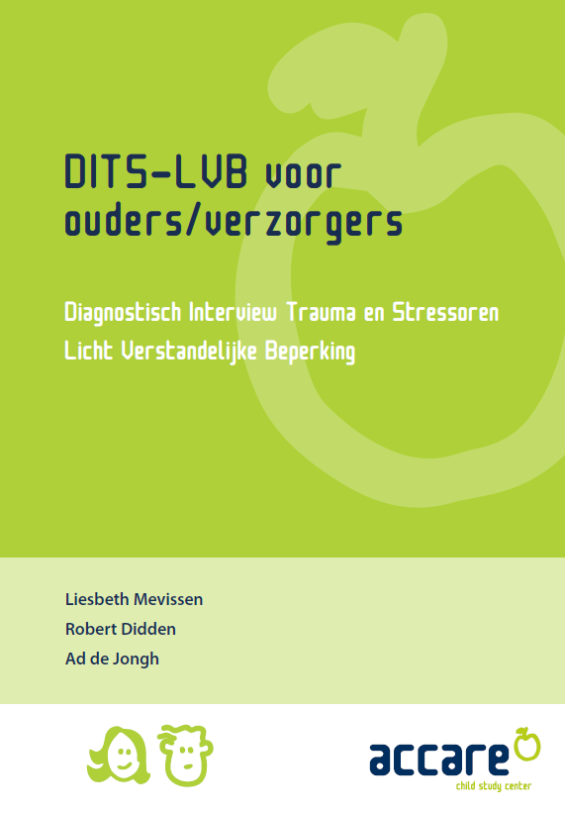
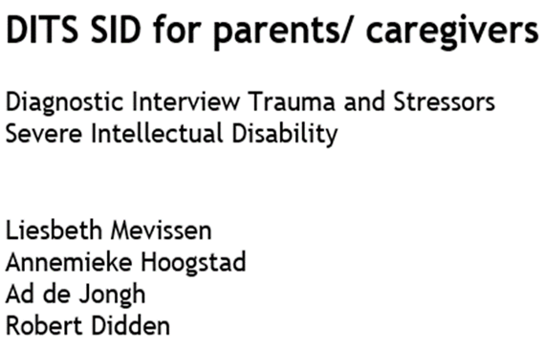

From DITS-ID to DITS-SID

Slide 9

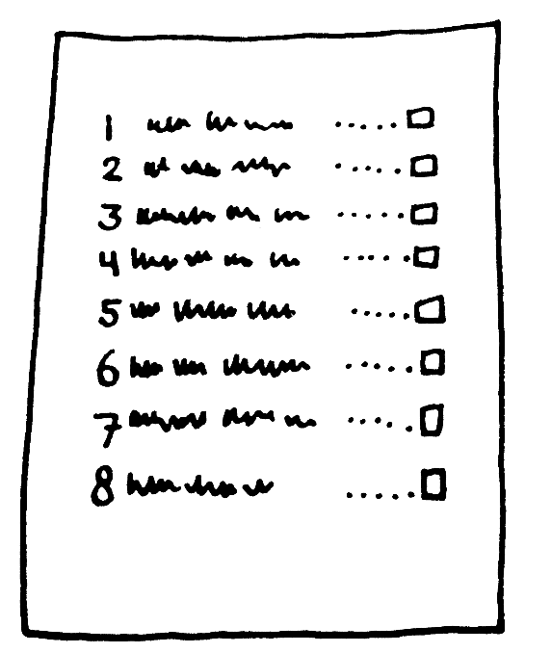

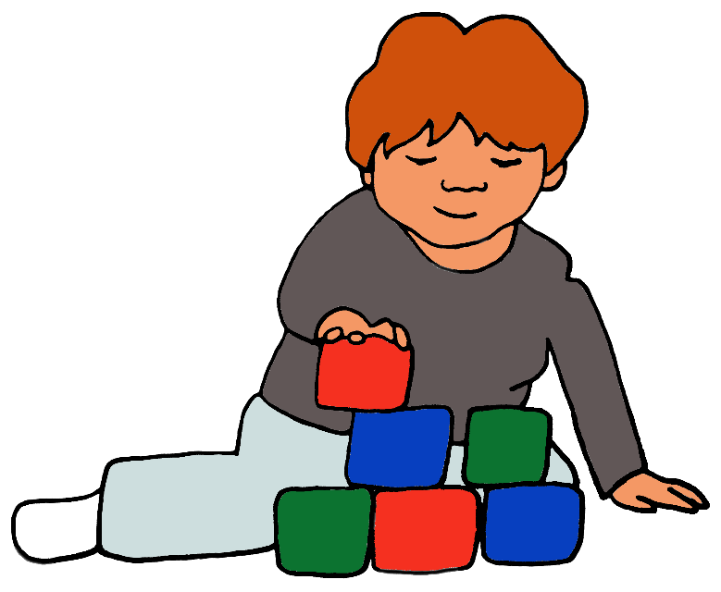
Based on

Slide 10

Psychometric properties?
PTSD manifestation?

Slide 11
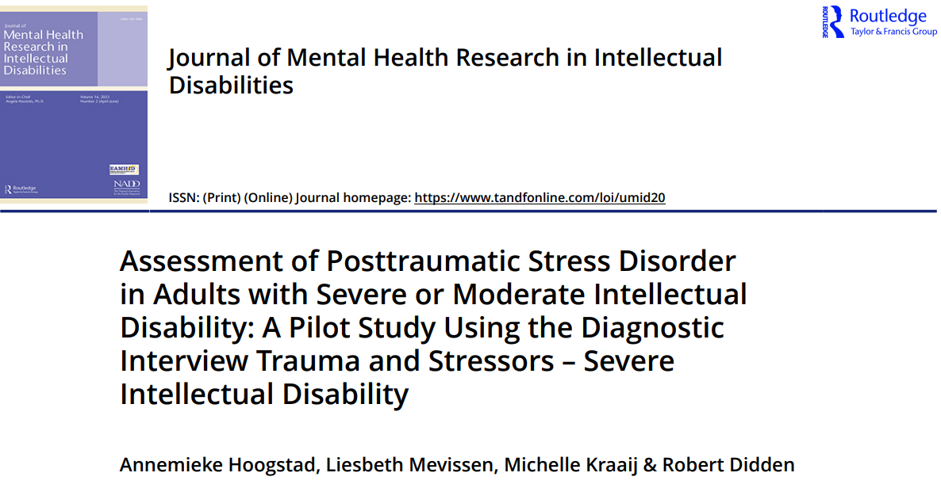
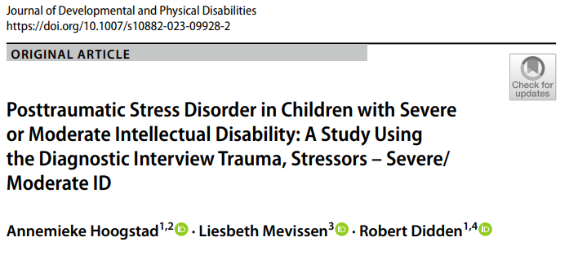
2 DITS-SID Pilots
26 adults
15 children

Slide 12

Results DITS-SID
Psychometric properties: promising
PTSD manifestation: DSM-5 ≤ 6Y-criteria seem appropriate
Risk diagnostic overshadowing
Challenging behavior: consider PTSD

Slide 13
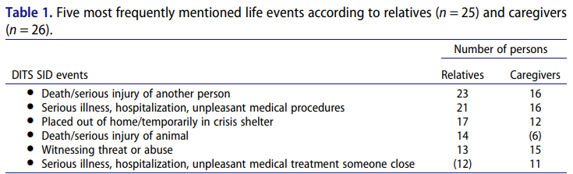
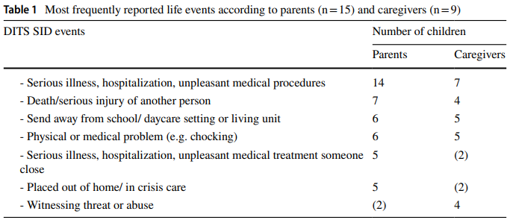

Most frequent life events
adults
children

Slide 14
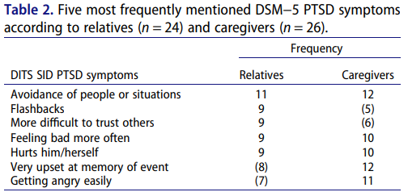
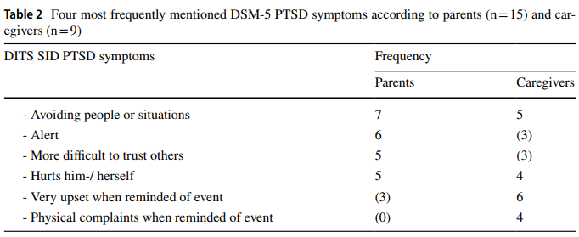

Most frequent PTSD symptoms
adults

Slide 15

Effect EMDR in Severe ID

Slide 16



Why EMDR

Slide 17
EMDR
https://www.youtube.com/watch?v=hKrfH43srg8

Slide 18
EMDR story telling method
≤ 4Y
Reading story traumatic memory
Client's perspective
Caregivers reads the story & client gets distracting task
Reactions and associations client

Slide 19
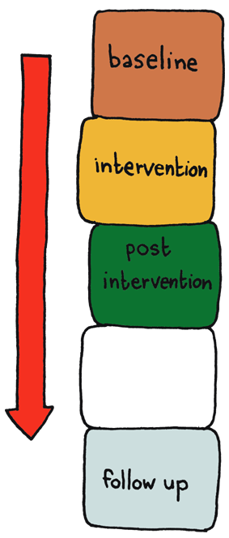
Pilot effect EMDR in SID
multiple baseline design
3 adults with SID and PTSD
PTSD symptoms, dysfunctional behaviors & CB’s

Slide 20

Video

Slide 21

recommendations recognizing PTSD
“If we do not look for it, we do not see it”
(Kildahl, Helverschou, Bakken & Oddli, 2020)
Asess trauma history (Rowsell et al., 2013)
Use a relative and a professional caregiver as informant

Slide 22
Recommendations treatment PTSD
Treatment is possible (EMDR)
Working together with system client
Have courage ↔ avoidance

Slide 23

Thank you!

