Slide 1



Differentiating ICD-11 Complex PTSD from Borderline Personality Disorder: Implications for Assessment and Treatment
Prof. Thanos Karatzias
Clinical & Health Psychologist
Edinburgh Napier University &
NHS Lothian Rivers Centre for Traumatic Stress

Slide 2

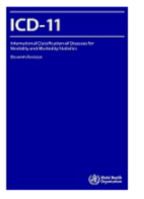
ICD-11 PTSD and Complex PTSD
“Gate” Criterion: Traumatic Stressor
PTSD | CPTSD
Re-experiencing | Re-experiencing
Avoidance | Avoidance
Sense of Threat | Sense of Threat
 | Affect Dysregulation
 | Negative Self Concept
 | Disturbed Relationships
Functional Impairment | Functional Impairment
Diagnosis is either PTSD or CPTSD: If PTSD and DSO criteria met = CPTSD
Type of trauma is a risk factor not a requirement for a diagnosis

Slide 3
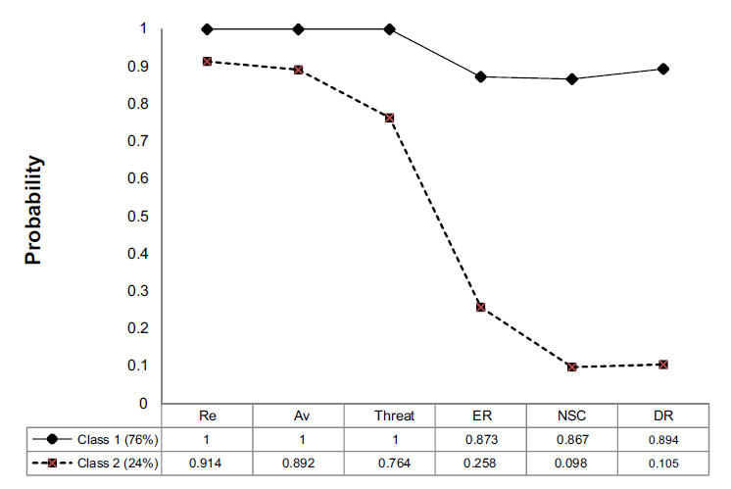
Evidence for ICD-11 CPTSD
Karatzias et al. (2017) Journal of Affective Disorders

Slide 4
ICD-11 CPTSD – Factorial validity results from treatment seeking samples
 | χ² | CFI | TLI | RMSEA (90% CI)
UK mixed clinical group (N = 615) | 116* | .974 | .964 | .052 (.040, .064)
Lithuanian clinical outpatients (N = 280) | 340* | .978 | .975 | .043 (.030, .059)
Syrian refugees in Lebanon (N = 112) | 271* | .946 | .938 | .056 (.037, .072)
Filipino soldiers (N = 450) | 807* | .978 | .975 | .076 (.071, .082)
Ukrainian internally displaced persons (N = 2,203) | 390* | .963 | .949 | .058 (.052, .063)
Mixed refugees in Switzerland (N = 134) | 57 | .981 | .974 | .040 (.010, .070)
Radican, Nolan, Hyland, Cloitre, McBride, Karatzias et al. (2021) Journal of Anxiety Disorders

Slide 5
ICD-11 CPTSD – Factorial validity results from general population samples
 | χ² | CFI | TLI | RMSEA (90% CI)
USA general population (N = 1,893) | 214* | .995 | .993 | .044 (.038, .050)
UK general population (N = 1,051) | 104* | .998 | .997 | .034 (.025, .043)
Irish general population (N = 1,020) | 128* | .990 | .986 | .041 (.033, .050)
Israeli general population (N = 1,003) | 118* | .982 | .975 | .053 (.041, .065)
Ghana/Kenya/Nigeria general population (N = 2,524) | 419* | .992 | .989 | .056 (.051, .061)
China/Japan/Taiwan/Hong Kong students (N = 1,344) | 481* | .981 | .968 | .063 (.057, .068)
Radican, Nolan, Hyland, Cloitre, McBride, Karatzias et al. (2021) Journal of Anxiety Disorders
Radican, Nolan, Hyland, Cloitre, McBride, Karatzias et al. (2021) Journal of Anxiety Disorders

Slide 6
Prevalence rates: General population samples
 | USA | Israel | Ireland | UK^** | Germany* | Ghana | Kenya | Nigeria
PTSD diagnosis | 3.4% | 6.7% | 5.0% | 5.3% | 1.5% | 17.6% | 20.3% | 17.4%
CPTSD diagnosis | 3.8% | 4.9% | 7.7% | 12.9% | 0.5% | 13.0% | 13.7% | 19.6%
Total | 7.2% | 11.6% | 12.7% | 18.2% | 2.0% | 30.6% | 34.0% | 37.0%
^Trauma exposure was a criterion for inclusion.
*Very narrow definition of trauma exposure applied.
**Karatzias et al. (2019) Depression and Anxiety

Slide 7
Prevalence rates: Treatment seeking samples
 | Welsh patients | Scottish patients* | Syrian refugees | Mixed refugees in Switzerland
PTSD diagnosis | 10.9% | 37.0% | 25.2% | 19.7%
CPTSD diagnosis | 53.6% | 53.1% | 36.1% | 32.8%
Total | 64.5% | 90.1% | 61.3% | 52.5%
*Karatzias et al. (2017) Journal of Affective Disorders
*Karatzias et al. (2017) Journal of Affective Disorders

Slide 8
Types of Trauma,
ICD-11 PTSD and CPTSD
Trauma Type
 | PTSD | CPTSD
Interpersonal Trauma | 91.0% | 97.1%
Childhood Trauma | 85.0% | 93.2%
Adulthood Trauma Only | 13.5% | 6.8%
Both Childhood and Adulthood Trauma | 85.0% | 93.2%
Karatzias et al. (2016) Journal of Anxiety Disorders

Slide 9
PTSD vs. CPTSD (n = 106)
 | ICD-11 PTSD |  | ICD-11 CPTSD
 | Mean | SD | Mean | SD | t | df | d
Depression | 9.73 | 3.71 | 12.43 | 4.76 | 2.05 | 78 | .63*
Anxiety | 14.20 | 3.23 | 16.14 | 4.55 | 1.56 | 78 | .49
Borderline Personality Disorder | 9.69 | 3.01 | 11.09 | 1.94 | 2.10 | 68 | .55*
Self-harm | .80 | .78 | 1.13 | 1.01 | 1.19 | 74 | .37
Dissociation | 9.00 | 3.36 | 14.37 | 6.76 | 2.98 | 73 | 1.01**
Hyland …. Karatzias (2018) Journal of Traumatic Stress

Slide 10
CPTSD: Service Utilisation (contact with a MH professional the last 12 months)
 | % | χ2 | OR (95% CI)
ICD-11 PTSD or CPTSD | 48.6% | 111.47, p < .001 | 6.75 (4.58, 9.95)
ICD-11 PTSD | 41.2% | 21.52, p < .001 | 3.68 (2.05, 6.59)
ICD-11 CPTSD | 58.2% | 100.69, p < .001 | 8.70 (5.36, 14.11)
Note: χ2 = chi-square test; OR (95% CI) = Odds ratio (95% confidence intervals).
Hyland, Vallières, Cloitre, Ben-Ezra, Karatzias et al. (2020). Social Psychiatry and Psychiatric Epidemiology

Slide 11
Differentiating CPTSD and BPD

Slide 12
ICD-11 PD
ICD-11 CPTSD
problems in functioning of aspects of the self (e.g., identity, self-worth, accuracy of self-view, self-direction)
and/or interpersonal dysfunction (e.g., ability to develop and maintain close and mutually satisfying relationships, ability to understand others’ perspectives and to manage conflict in relationships) that have persisted over an extended period of time (e.g., 2 years or more).
The disturbance is manifest in patterns of cognition, emotional experience, emotional expression, and behaviour that are maladaptive (e.g., inflexible or poorly regulated) and is manifest across a range of personal and social situations (i.e., is not limited to specific relationships or social roles)..
exposure to an event or series of events.
PTSD symptoms
severe and pervasive problems in affect regulation
persistent beliefs about oneself as diminished, defeated or worthless, accompanied by deep and pervasive feelings of shame, guilt or failure related to the traumatic event
persistent difficulties in sustaining relationships and in feeling close to others.
DSO

Slide 13
LCA Analysis on a sample of multiply traumatised individuals
Four distinct classes of individuals:
A CPTSD/High BPD (43.1%)
A CPTSD/Moderate BPD class (40%)
A PTSD/Low BPD class (16.9%)
The two CPTSD classes were associated with greater exposure to multiple, interpersonal traumas earlier in life and exhibited higher functional impairment.
Jowett, Karatzias, Shevlin, Albert (2020). Personality Disorders: Theory, Research, and Treatment

Slide 14
Exploratory structural equation modelling (ESEM) on a traumatised sample from the UK general population
A three-factor model with latent variables reflective of ‘PTSD’, ‘DSO’, and ‘BPD’ symptomatology provided the best fit of the data.
The PTSD, DSO, and BPD factors were all positively associated childhood interpersonal trauma.
Hyland, Karatzias Cloitre, Shevlin (2019) Journal of Traumatic Stress

Slide 15
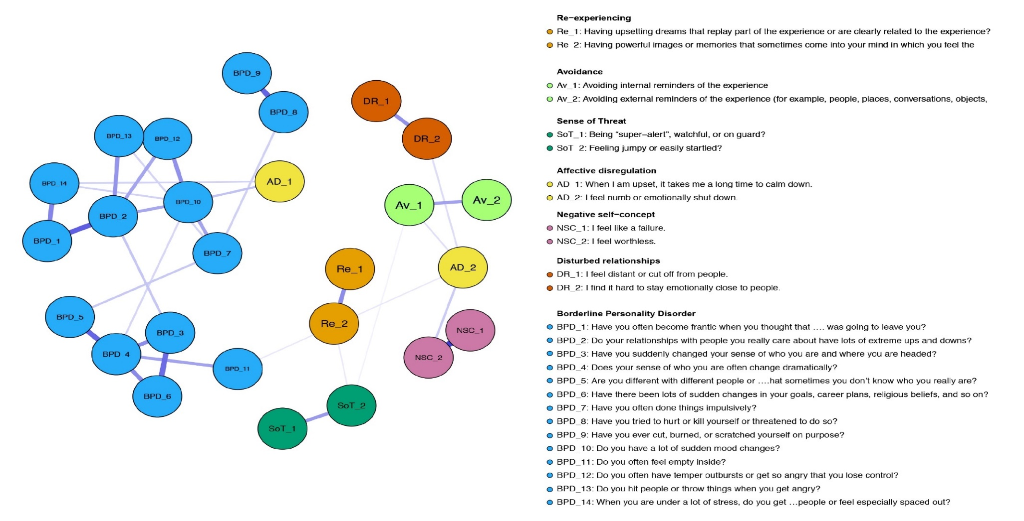
A network analysis in a highly traumatized sample
Owczarek, Karatzias et al. (2022) Journal of Personality Disorders

Slide 16
2 key findings
BPD and CPTSD are largely separated.
Affective Dysregulation items were the only items related to BPD.
Owczarek, Karatzias et al. (2022) Journal of Personality Disorders

Slide 17
CPTSD in those with a primary diagnosis of EUPD
100% EUPD (n=42 inpatient sample)
66.7% (n=28) met diagnostic criteria for either PTSD (n=5, 11.9%) or CPTSD (n=23, 54.8%)
Morris et al. (2021): Abuse: An international Impact Journal

Slide 18
EUPD, Complex PTSD and functional impairment
“sense of threat and disturbances in relationships were significant predictors of functional impairment severity when controlling for other symptom clusters”
Webb, Morris et al. (2022): European Journal of Trauma and Dissociation

Slide 19
Overall evidence suggest that different symptom clusters might be more prominent depending on primary diagnosis:
CPTSD: Disturbed self-concept
CPTSD + EUPD: Affect Dysregulation
EUPD: Disturbed Relationships

Slide 20
Emotional Regulation
CPTSD
BPD
reactive anger and substance misuse
self-injurious behaviours and suicidality
Disrupted Sense of self
sense of self is defined as a stable, deeply negative self-perception
highly unstable and alternating between polarised positive and negative self-perception
Disturbed Relationships
difficulties stem from mistrust, associated with being hurt, and are kept at a distance more consistently
volatile and oscillating between intensely idealised and disparaging

Slide 21
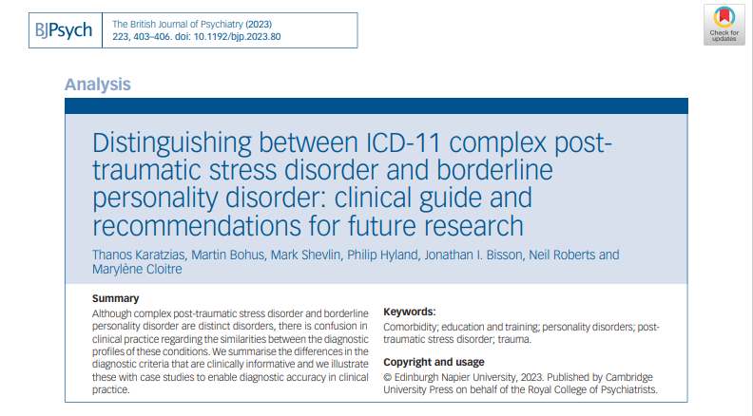
Clinical Guideline

Slide 22
Treating overlapping CPTSD and BPD
Targeting CPTSD?
Targeting BPD?
Targeting Affect Dysregulation or any other DSO sympotms?

Slide 23
CPTSD Treatment:
Where are we?
ICD-11 Complex PTSD (CPTSD) is a new condition and there are as yet no clinical trials for its treatment.
There is a substantial evidence base on the treatment of PTSD.

Slide 24
PTSD treatment
EMDR vs. TfCBT vs. WL
Power et al… Karatzias, 2002 Clinical Psychology and Psychotherapy
Karatzias et al., 2007 European Archives of Psychiatry and Clinical Neuroscience
Karatzias et al., 2011 Journal of Nervous and Mental Disease

Slide 25
Are existing therapies effective for CPTSD?

Slide 26
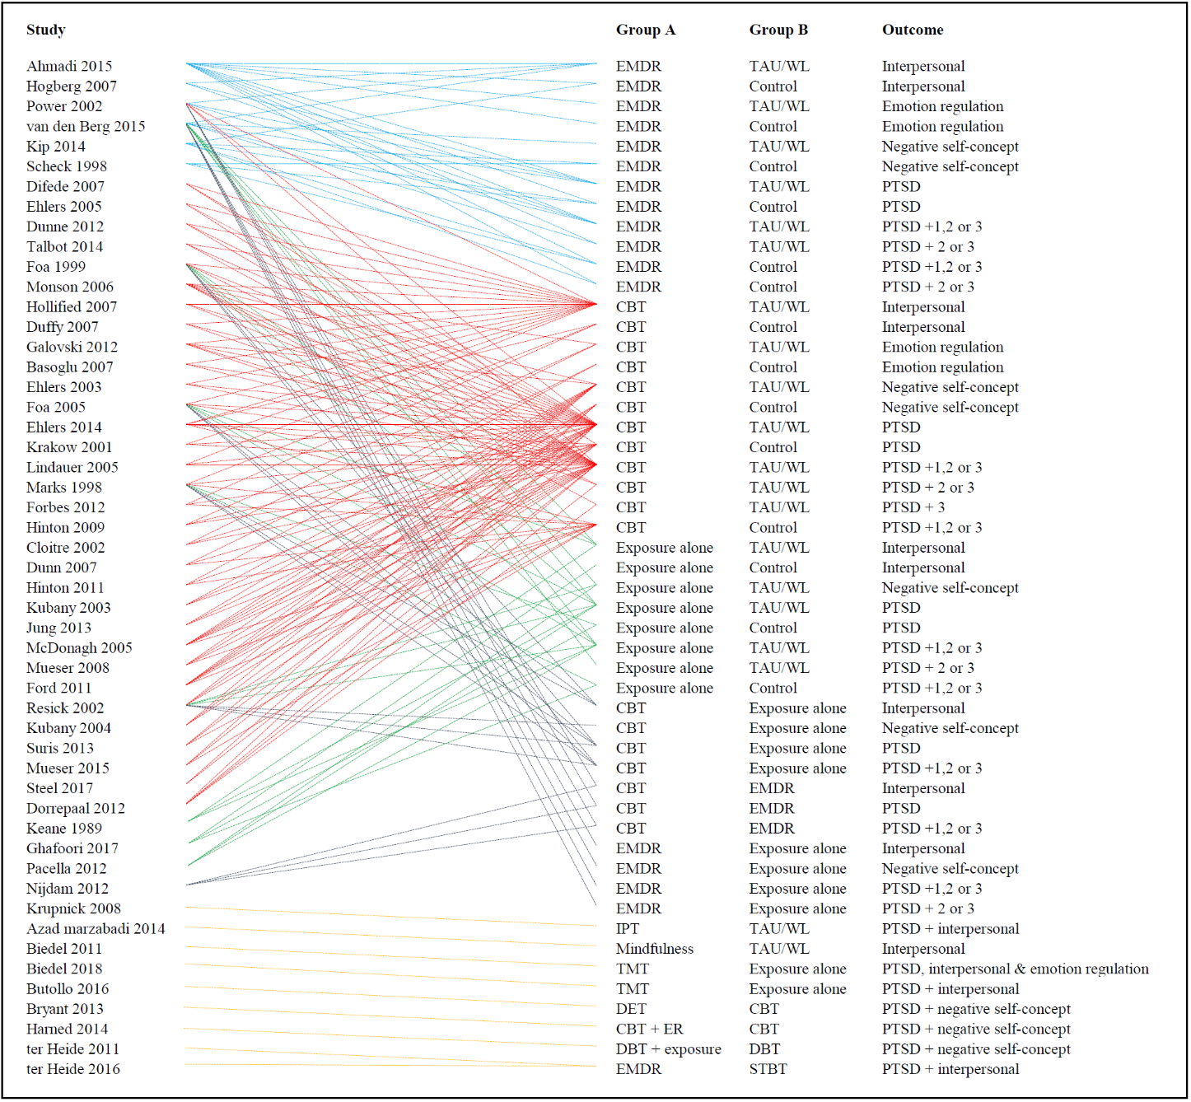
Metanalysis of existing therapies for CPTSD
Karatzias et al. (2019) Psychological Medicine

Slide 27
Life events in a community treatment seeking sample
N= 195
Childhood Trauma (CTQ) |  | Adulthood Trauma (LEC)
Emotional Abuse | 70.3% | Physical assault | 80.5%
Emotional neglect | 63.1% | Sexual Assault | 58.5%
Sexual abuse | 55.9% | Weapon Assault | 51.6%
Physical abuse | 54.9% | Transport Accident | 50.3%
Physical neglect | 52.8% | Other Unwanted Sexual Experience | 48.7%
Any Childhood Trauma | 82.1% | Multiple Life Events (2-12) | 94.6%
Multiple abuses | 70.8% | Adulthood Trauma only | 16.4%
Interpersonal Trauma (Childhood or Adulthood) | 93.7%
Interpersonal trauma only (Childhood or adulthood) | 10.3%
Childhood Trauma only | 0.0 %
Childhood and Adulthood Trauma | 82.1%
Karatzias et al. (2016) Journal of Affective Disorders

Slide 28
Life events in a prison population
N= 112
Childhood Trauma (CTQ) |  | Adulthood Trauma (LEC)
Emotional Abuse | 77.5 | Physical assault | 75.3
Emotional neglect | 78.7 | Sexual Assault | 55.1
Sexual abuse | 50.6 | Weapon Assault | 51.7
Physical abuse | 59.6 | Serious harm caused to someone else | 49.4
Physical neglect | 65.2 | Other Unwanted Sexual Experience | 53.9
Multiple abuses | 55.1 | Any Life Event | 84.2
Howard, Karatzias et al. (2016), Clinical Psychology and Psychotherapy
Howard, Karatzias et al. (2016), Social Psychiatry & Psychiatric Epidemiology
Facer-Irwin, Karatzias et al. (2020), Psychological Medicine

Slide 29
Adverse Childhood Events
Population Based Studies (2018 -19)
Adverse childhood event | UK* % | Ireland % | USA % | Israel %
Verbal abuse by a parent or caregiver | 36% | 36% | 21% | 27%
Physical abuse by a parent or caregiver | 34% | 28% | 16% | 23%
Sexual abuse by a parent or caregiver | 16% | 16% | 18% | 19%
Emotional neglect by a parent or caregiver | 36% | 30% | 17% | 23%
Physical neglect by a parent or caregiver | 10% | 10% | 5% | 5%
Parents separated or divorced | 31% | 20% | 34% | 16%
Witnessing physical violence between parents or caregivers | 16% | 13% | 12% | 9%
Alcohol or drug use in the family home | 18% | 26% | 25% | 8%
Mental illness in the family home | 25% | 23% | 16% | 15%
Household member went to prison | 7% | 7% | 8% | 3%
*Karatzias et al. (2019), Depression & Anxiety

Slide 30
What do we know about the treatment of CPTSD?

Slide 31
Metanalysis of Group Therapies for Complex Interpersonal Trauma
Phased 1 interventions can be useful for symptoms of general distress (e.g. anxiety and depression).
Phased 2 (Trauma Focused) interventions are required for traumatic stress.
Mahoney, Karatzias, Hutton (2019). Journal of Affective Disorders

Slide 32
Pilot RCT of Phase 1 Interventions
N = 86 female prisoners with interpersonal trauma.
10 sessions of Phase 1 (group psychoeducation) vs. standard care.
Group psychoeducation achieved only small effect sizes in comparison to usual care across all outcomes including behavioural problems, emotional regulation and psychopathology.
Mahoney, Karatzias et al. (2020). Clinical Psychology & Psychotherapy

Slide 33
Metanalysis of psychological and pharmacological interventions for PTSD following complex trauma
Multicomponent interventions that included skills-based strategies along with trauma-focused strategies are the most promising interventions for emotional dysregulation and interpersonal problems in people with complex trauma.
Multicomponent interventions that included cognitive restructuring and imaginal exposure were the most effective for reducing PTSD symptoms.
Coventry, Meader, Melton, Temple, Dale, Wright, Cloitre, Karatzias et al. (2020). PLOS Medicine

Slide 34
What about acceptability of therapies?
Patients with complex trauma have high attrition rates compared to those with PTSD.
Patient centred approaches can be helpful in reducing attrition rates in psychological therapies.
Coventry, Meader, Melton, Temple, Dale, Wright, Cloitre, Karatzias et al. (2020). PLOS Medicine

Slide 35
Person centered care
4 core principles:
Affording people dignity
Compassion and respect
Offering coordinated and personalised care, support or treatment
Supporting people to recognise and develop their own strengths and abilities to enable them to live an independent and fulfilling life.
In this framework, the role of the health care professional is to enable the individual to make decisions about their own care and treatment on the basis of their needs (Health Foundation, 2014)

Slide 36
Modular therapy for CPTSD: A person centered approach
A thorough assessment of the patient’s presenting problems resulting in a case formulation about the underlying causes.
Therapist and patient decide on specific CPTSD clusters to target based on preference, readiness and severity using appropriate evidence based interventions.
At the end of delivery of this module, an assessment is conducted and the next therapeutic target is selected.
Karatzias & Cloitre (2020). Journal of Traumatic Stress

Slide 37
A new modular treatment protocol for CPTSD
Enhanced STAIR (ESTAIR) Narrative Therapy for CPTSD (Cloitre, Karatzias, McGlanachy, 2019)
Based on STAIR model (Cloitre et al., 2002, 2010)
25 sessions: 6 sessions per cluster (Self-concept, affect regulation, interpersonal relationships, PTSD) + a formulation session prior to start of treatment.

Slide 38
Treating overlapping CPTSD and BPD
New area of enquiry
    Understanding the role of childhood polytraumatisation.
There is a need for further clinical research in this area…
    Targeting CPTSD (Modular therapies)
    Targeting BPD (DBT)
    New models addressing specific overlapping symptoms (affective dysregulation)

Slide 39
Conclusions
CPTSD and BPD are distinct conditions but can co-occur in a small percentage of individuals.
Emotional dysregulation seems to be responsible for the overlap between CPTSD and BPD.
Establishing primary diagnosis is important.
There is a need for more clinical research in addressing the comorbidity between CPTSD and BPD.

Slide 40

Thank you for attending

