Slide 1
Listening and responding
Dr Carmel Digman DClinPsy
Canterbury Christ Church University

Slide 2
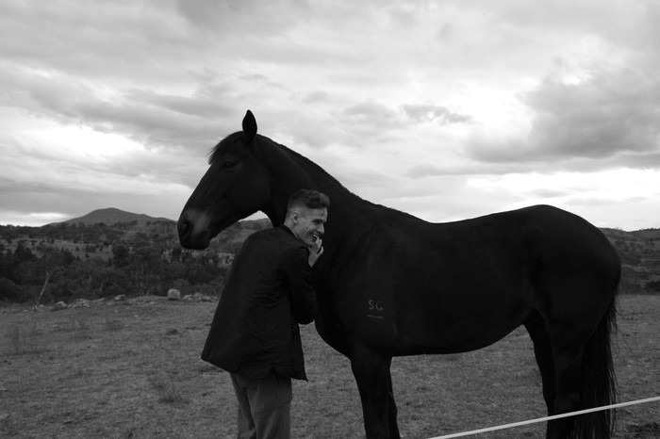
The characters:
James ~ sociable, adventurous, with a small group of close friends, confident away from home.
George ~ physically active, liked to help with outdoor tasks, loved horses and military history.
Maria ~ sang songs and enjoyed toys and games, liked to have her hair brushed.

Slide 3
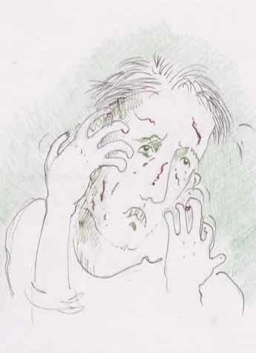
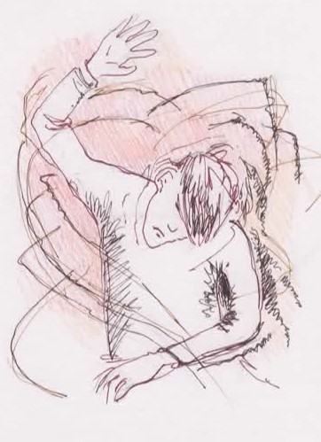
Symptoms of distress
Crying; screaming; self-injury and attacking others; sleep & eating disturbance; withdrawal; anxiety and fear; dissociative symptoms; deep sadness; waking nightmares (flashbacks).

Slide 5
Summary of Therapy approaches
Affirmation of feelings
Grounding in place and time
Reassurance
Psychotherapeutic and narrative approaches
Working with the body (physiotherapy, swimming, walking)
Intensive Interaction

Slide 6
Affirmation of feelings
A need to be alongside and together with the person.
A process of building rapport, tolerating presence.
Containment of feelings. Affirming those that are overwhelming and frightening as natural, understandable and survivable.
Recognising feelings that are not expressed verbally or present as violence, self-injury, rejection.

Slide 7
Grounding in place and time
Recognising ‘flashbacks’, dissociative states, emotional dislocation.
Grounding the body, re-educating autonomic reactions?
Providing respite; rest, recuperation.

Slide 8
Reassurance
Anticipating situations that might trigger traumatic memories and preparing for these
Speaking to the moment, the reality of what is happening
Reassuring on those things you know the person fears
Repeating reassurances as the person learns to self-reassure.

Slide 9
Psychotherapeutic and narrative approaches: modifying therapies
Communicating is mostly non-verbal so communication of emotions and affect can take place without words
Telling of stories and retelling stories
Enabling narratives
Bringing back normality as the person recovers

Slide 10
Working with the body
Improving physical health through tolerated exercise and activity
Keeping physical health in mind
Opening spaces, outdoors, swimming, walking, natural environments
Tolerating being with others

Slide 11
Intensive Interaction
Entering into the trauma space with the person
Tuning in and building tolerance of presence
Mirroring the feelings and actions
Containing and bringing down the intensity
Changing the tone

Slide 13
Resilience
Previous experience of secure and loving home lives
Morality
Bravery
Family & carer responses

Slide 14
References
References
Byrne, G. (2018). Prevalence and psychological sequelae of sexual abuse among individuals with an intellectual disabilitiy: a review of the recent literature. Journal of Intellectual Disabilities. 22(3). 2940310.
Byrne, G. (2020). A systematic review of treatment intervention for individual with intellectual disability and trauma symptoms: a review of the recent literature. Trauma, Violence & Abuse. Electronic publication. https://doi.org/10.1177/1524838020960219
Digman, C. (2021). Lost voices pt 1: a narrative case study of two young men with learning disabilities disclosing experiences of sexual, emotional and physical abuse. British Journal of Learning Disability. 49. 195-204.
Digman, C. (2021). Lost voices pt 2: modifying psychological therapies for two young men with complex learning disabilities following alleged sexual and physical abuse: a case study in trauma recovery. British Journal of Learning Disability 49. 205-216.
Markowitz, J. (2017). Interpersonal psychotherapy for post traumatic stress disorder. Oxford University Press.
Scharloo, A., Ebbers, S., & Skijker, M. (2017). Psychological first aid for people with intellectual disabilities who have experienced sexual abuse. Jessica Kingsley.

Slide 15
Brown, H. & Turk, V. (1992). Defining sexual abuse as it affects adults with learning disability. Mental Handicap. 20, 44-55.
Byrne, G. (2017) Prevalence and psychological sequelae of sexual abuse among individuals with an intellectual disability: A review of the recent literature. Journal of Intellectual Disabilities. Vol 22(3), 294-310.
Corbett, A., Cottis, T. & Morris, S. (1996). Witnessing, nurturing, protesting: Therapeutic responses to sexual abuse of people with learning disabilities. London, David Fulton.
Denborough, D. (2014). Retelling the stories of our lives: Everyday narrative therapy to draw inspiration and transform experience. Norton and Company
Gil-Llario, M., Morell-Mengual, V., Diaz-Rodreiquez, I. & Ballester-Arnal, R. (2018). Prevalence and sequelae of self-reported and other reported sexual abuse in adults with intellectual disability. Journal of Intellectual Disability Research. Vol. 10.
Hollins, S., & Sinason, V. (2000). Psychotherapy, learning disabilities and trauma: New perspectives. British Journal of Psychiatry, 176, 32–36. https://doi.org/10.1192/bjp.176.1.32
Markowitz, J. (2017). Interpersonal psychotherapy for posttraumatic stress disorder. Oxford University Press
Murphy, G., O’Callaghan, A., & Clare, I. (2007). The impact of alleged abuse on behaviour in adults with severe intellectual disabilities. Journal of Intellectual Disability Research 51:10, 741-749.
Rothschild, B. (2000). The body remembers: The psychophysiology of trauma and trauma treatment. W W Norton & Company.

