Slide 1
Using the Neurosequential Model of Therapeutics© to reduce restrictive practice
Emma longfellow
Consultant and Lead Psychologist
&
Anthony Webster
Trainee Forensic Psychologist
National High Secure Learning Disability and Autism Service

Slide 2
Overview
Introduction to the Neurosequential Model ©
How it might support reducing restrictive practice.
KALMAR tool
Summary

Slide 3
Introduction to the neurosequential model©

Slide 4
INTRODUCTION To NMT (Perry, 2008)
NMT is a neuroscience informed approach that looks to operationalize neurobiological understanding into clinical interventions.
It was developed by Bruce Perry (2008) primarily for work with Children and adolescents who have experienced adversity but is applicable to the adults these children become
This Model is underpinned by two core principals;
1. The brain develops sequentially
2. The brain is use dependent
Extent and timing of trauma or neglect can cause significant damage to the functioning of the brain & impair emotional, cognitive and social skill development a child will need for life.
NMT works to identify where brain functioning has been negatively affected and make recommendations for carers

Slide 5
Hierarchical Organisation of the human brain.

Slide 6
“All experience is processed from the bottom up, meaning, to get to the top, “smart” part of our brain, we have to go through the lower, not-so smart part. This sequential processing means that the most primitive, reactive part of our brain is the first part to interpret and act on the information coming in from our senses
Bottom line: Our brain is organized to act and feel before we think.”
WHTY B. Perry (p29)

Slide 7
State dependen functioning

Slide 8
How can knowing this help reduce restrictive practice

Slide 9
Utility in supporting reduction in restriction
NMT© is a Trauma Informed model of work….and more
NMT© helps clinicians and staff better understand “sensitivity” that is common in Developmental trauma.
Shifts the narrative from “what is wrong with you” to “what happened to you”
Recognises and enables co-regulation (prevent co-dysregulation)
NMT© emphasises the importance of State Dependent Functioning (SDF)helping staff to recognise that progress and skill application fluctuates.
SDF helps staff to understand that at times verbal interactions and commands are ineffective and escalating.
It focusses on creating proactive regulatory interactions and environments that helps move away from managing behaviours reactively
Without this shift in understanding systems can inadvertently increase high risk behaviours contributing to unsuccessful transition and repeat admission.

Slide 10
Rapid Evidence Assessment (REA) a. Webster (2023 unpublished)
4 Papers have been published that consider the impact of NMT on reducing restrictive practice in forensic settings.
It is an emerging area with the papers published between 2014 -2023
All highlight the need for quality training from a counter current perspective.
Although there were challenges noted in evaluating a framework such as NMT 3 of the papers noted reductions in restraints (2 were statistically significant)
Hambrick et al 2018 note significant organisational benefits associated with the reduction in restriction
Those under restrictive practice require higher dosing and relevant sequencing of interventions

Slide 11
if we know where they are functioning, we can adjust our response

Slide 12
the KALMAR tool
Practical ideas for healing sensitised responses.

Slide 13
KALMAR tool - Marti Smith
KALMAR (pronounced “Calmer”) is a tool to help identify therapeutic activities and approaches that are most likely to have positive outcomes based on observations made by caregivers. The theory for the tool is based on work by Dr. Bruce Perry and his NMT© model from the Neurosequential network as well as the TBRI method from The Karyn Purvis Institute for Child Development.
The 16 questions are modeled after the Neurosequential Model of Therapeutics© Metric developed by Dr. Perry and his colleagues. Based upon the ratings (appropriate to concerning), those activities are cross-referenced and weighted in regard to the likelihood that it will be beneficial for the individual.

Slide 14
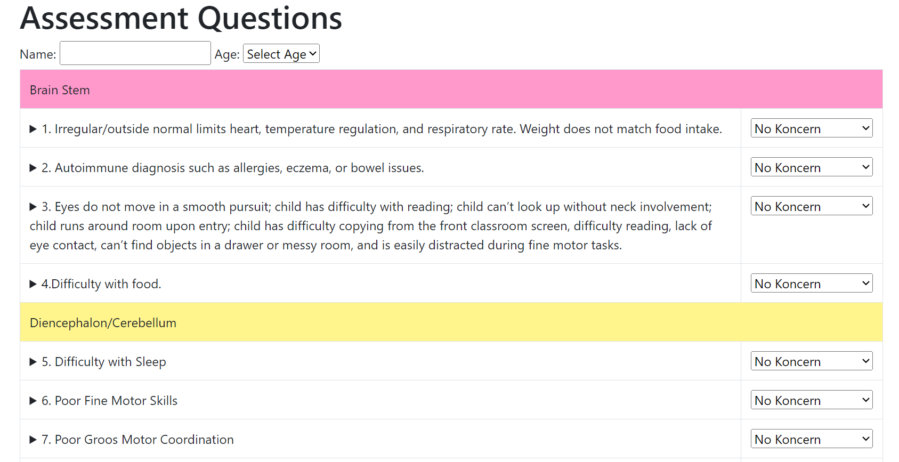
The Kalmar Tool - marti Smith http://kalmar.creativetherapies.com/Assessment/Questions
.

Slide 15
Use of the KALMAR tool within the National HSLD service
Intensive Care Unit in High Secure Learning Disability Services 7 patients – all Mild LD
4 Managed under Long Term Segregation (LTS) with varying reductions in restriction however not outside of room more than ½ their usual day – a Kalmar assessment was completed on each of those under LTS
Restricted due to types of behaviours that fall on a continuum
life threat assault--------------------------→Repeated critical incidents
Client | Age | Brain Stem | DE | Limbic | FC/C | Length of LTS to date
D | 30+ | 10 | 6 | 10 | 7 | 3 years
J | 25+ | 9 | 10 | 11 | 11 | 2 years
S | 20+ | 10 | 8 | 12 | 12 | 5 years
M | 30+ | 6 | 6 | 9 | 11 | 1 ½ years

Slide 16
Using the Kalmar to support treatment planning
Example output from assessment & corresponding plan

Slide 19
Changing the pathway for our LTS patients
Typical pathway
Reduction in risk through FBA/ Chain analysis/ PBS/ CBT/ SALT (talking therapies). Commonly reduced activities/ OT and reduced connection through physical security.
Renewed Pathway
Higher frequency of alerting and calming interventions, predictable, focus on relational aspects, stage and state aware – linked to concept of dosing and frequency with particular emphasis on meaningful interaction. Bottom-up approach ….need to walk before we run……

Slide 21
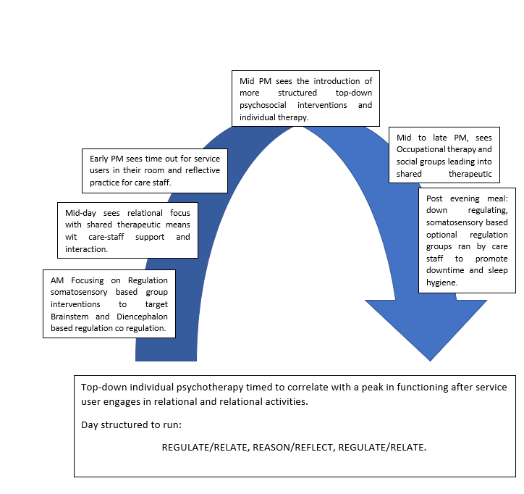

Slide 22
Summary
NMT© provides a useful framework for understanding brain development and the impact of trauma
There is existing studies to support this and its use in ID but we need more
The focus on sequence of engagement and state dependent functioning can help staff support regulation and reduce escalation
Exploring proactive somatosensory regulation strategies to support the foundations for Cortical modulation is important
The Kalmar can help provide practical activities and focus to do this
Understanding sensitised stress responses as underpinning risk behaviours can help challenge the systems tendency to explicitly and implicitly restrict contact and regulatory activities

Slide 23
THANK YOU for listening
Emma Longfellow, Consultant Psychologist
Emma.longfellow@nottshc.nhs.uk
Anthony Webster, Trainee Forensic psychologist
Anthony.webster@nottshc.nhs.uk

