Slide 1
Helping distressed people with intellectual disability to manage their chaotic emotions
Jennifer Clegg
Adjunct Professor, La Trobe University, Australia;
Retired consultant clinical psychologist & family therapist
&
RICHARD LANSDALL-WELFARE
Retired Clinical Director & Consultant Psychiatrist

Slide 2
Mindset on intervention in ID is shifting
From individuals to relationships: co-regulation
From behaviour to emotions: Attachment
From melanges to specialisation
From talk to embodied emotions: Psychomotor Therapy

Slide 3
1. ANTHROPOLOGICAL work on relationships: Kulick & Rydström (2015)
Sweden: ‘Talk is a site where people congratulate themselves for taking action’
Denmark: ‘Wildly politically incorrect language coexists with policies and practices that are politically radical and ethically progressive’
See also McKearney, P. (2022). Disabling violence: intellectual disability and the limits of ethical engagement. Journal of the Royal Anthropological Institute, 28(3), 956-974. https://doi.org/10.1111/1467-9655.13773

Slide 4
2. Emotional devel lags well behind cognitive devel. in ID. An untapped potential for personal growth
Few complex people become autonomous
Meet chaotic emotions with emotional co-regulation
SED-S assessment: staff teams & parents understand & support emotional growth
CaPDID brings co-regulation to direct care staff

Slide 5
2. From behaviour to emotions: Attachment
Confusion: ‘attachment parenting’ has been widely criticised by researchers as in error and on occasion (the recommendation to co-sleep) positively dangerous

Slide 6
2. Level of emotional not cognitive development predicts CB severity
Domain 1: Relating to His/Her Own Body
Domain 2: Relating to Significant Others
Domain 3: Dealing with Change
Domain 4: Differentiating Emotions
Domain 5: Relating to Peers
Domain 6: Engaging with the Material World
Domain 7: Communicating with Others
Domain 8: Regulating Affect

Slide 7
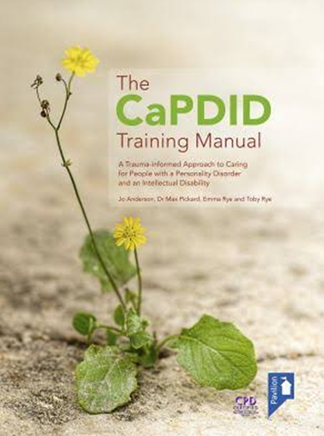
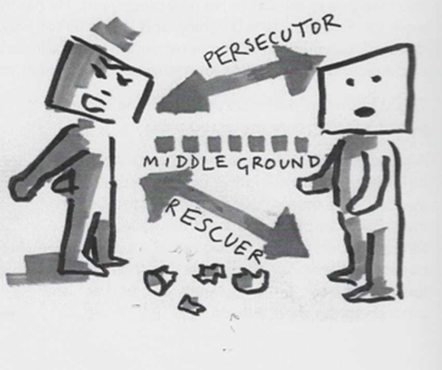
CaPDID: Caring for people with Personality Disorder & Intellectual Disability
DISTRESSED PEOPLE PULL & PUSH staff FEELINGS
HERO to ZERO
HERO
Special
Good at job
Wary – me next
ZERO
Guilty
I’ve failed
Helpless

Slide 8
↑Adverse Childhood Experiences predict Disorganised attachments predict PDs
PLANNING
Needs deep thinking
Safe environment
middle ground
Validation
What: 3x2hr sessions For: 12 direct care staff
By: Mental health professionals kmpt.capdidtraining@nhs.net
About Disorganised attachments, personality disorder, & their impact on us
Process incidents in past week
Recognise & avoid splitting
Emotional debrief
Hero to Zero
Persecutor-rescuer
Dangerous-vulnerable
Name feelings communicated by service user
Also validate staff eg dissociation as coping

Slide 9
3. The problem of melanges
PBS: the application of the science of applied behaviour analysis in the support of people with challenging behaviour. (La Vigna & Willis 2012; Gore et al 2013)
Secondary: other complementary evidence-based approaches
Attachment : a cognitive-emotional system that directs people towards specific others in their immediate social world who are perceived to be wiser and stronger, & willing to share their resources. This system is highly active … whenever life’s challenges outstrip personal resources. Patterns of attachment reflect cognitive-affective processing that emerge from history of social relationships. (Schuengel et al 2016).
Since attachment & PBS are incompatible ideas:
Inevitably, the dominant one – PBS – gets enacted

Slide 10
4. Psychomotor Therapy: Combines physiotherapy and psychology
1. Social life of people with ID is embodied more than carried in language
Clifford Simplican, S (2015). The capacity contract. Minnesota.
2. Works with heavily defended people in deep denial
Bellemans, T et al l(2022) Psychomotor therapy for individuals with mild IDs or borderline intellectual functioning…. Journal of Intellectual & Developmental Disability, 47:1, 7486, DOI: 10.3109/13668250.2021.1899561
Smit, M. J. (2023) Sexual abuse in individuals with ID: a psychomotor perspective. Vrije Universiteit, Amsterdam. ISBN: 978-94-6469-464-2

Slide 11
4. The feasibility of psychomotor therapy (2016) Kay, Clegg, Emck, Standen
Anna
intermittent hypomania
Body awareness very limited
Ran away from mirror exercise in great distress
PMT: Became better able to notice early stages of bodily arousal and act to reduce it
Care staff continued to intervene when arousal moved beyond her control
Tom
Psychosomatic pain; taking knives to cut it out
Body awareness very limited
PMT:
became more alert to changes in his body during and after exercise
& persisted in physical activity despite mild discomfort
2 years post-discharge:
no recurrence of serious self-harm
remained settled in new group home

Slide 12
Supporting data and literature
Clegg, J.A. & Lansdall-Welfare, R. (2022). Helping distressed people with intellectual disability to manage their chaotic emotions. Research and Practice in Intellectual and Developmental Disabilities, https://doi.org/10.1080/23297018.2022.2106146
Kay, J. Clegg, J. A. Emck, C. Standen, P. J. (2016). The feasibility of psychomotor therapy in acute mental health services for adults with intellectual disability. Journal Intellectual and Developmental Disabilities, 41(1), 54-60. http://dx.doi.org/10.3109/13668250.2015.1094037
Clegg, J.A. (2023). Can we reduce restrictive practices and maintain safety? Commentary on “Australian work health and safety enforcement regarding service provision to people with disabilities: lessons for service providers” (Hough, Bigby, & Marsh, 2023). Research and Practice in Intellectual and Developmental Disabilities. https://doi.org/10.1080/23297018.2023.2244518
Webb, J. Pilnick, A. Clegg. J. (2018). Imagined Constructed Thought: How Staff Interpret the Behavior of Patients with Intellectual Disabilities, Research on Language and Social Interaction, 51:4, 347-362. https://www.tandfonline.com/eprint/MBkefgsAejmsW3P8x6Gq/full

Slide 13
Thank you
Comments or questions welcome
J.Clegg@latrobe.edu.au

Slide 14
Moving beyond political focus on ‘restrictive practices’
Norwegian Social Service Act (1999) Restraint in ID had to be formally registered & documented.
UNCRPD 2006 article 16 (of 50)
States shall ensure that instances of exploitation, violence and abuse against persons with disabilities are identified, investigated &, where appropriate, prosecuted
Bureaucratising fails: restraint in Norway increased 5-fold (Sondenaa 2015)
Netherlands (Schippers et al, 2018) Policy-makers: client self-determination
Care staff: safety for all
Safety vs restrictive practices: Taylor (2021), Clegg (2023)
Australia 2023:

