Slide 1

Disregarded ghosts of contested nurseries:
Experiences of interpersonal trauma among parents with intellectual disability
Mårten Hammarlund
Lic. clinical psychologist, Lic. child psychotherapist, Spec. Psy. in clinical child psychology, The Erica Foundation
PhD candidate in developmental psychology, Stockholm University

Slide 2
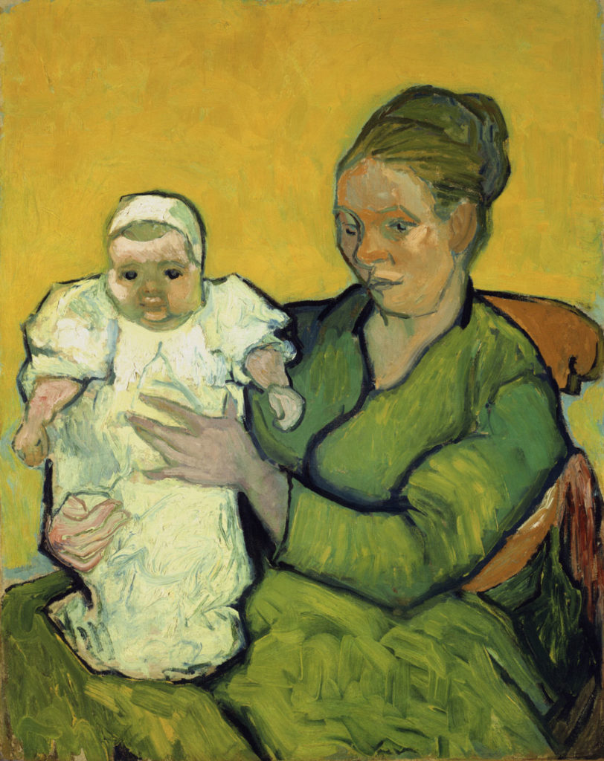

Background
Parents with intellectual disability (ID) have a heightened risk for caregiving-related difficulties.
  Heightened risk for maltreatment (e.g., De Zelar & Lightfoot, 2020 McConnell et al., 2021; Wickström et al., 2017; Willems et al., 2007).
  Lower maternal sensitivity (Lindberg et al., 2017).
  Possibly less stimulating interactions (e.g., Aunos et al., 2008; Keltner et al., 1994).
  Heightened risk for observed parenting problems (Emerson & Brigham, 2014).
Their children also have a heightened risk for developmental delays (e.g., Emerson & Brigham, 2014; Orthmann Bless, 2021), mental-health problems (e.g., Neely-Barnes et al., 2014), and behavior problems (Cleaver & Nicholson, 2007; McConnell et al., 2011).
Van Gogh (1888), ”Mother Roulin and her baby”

Slide 3

Background
These risks have often been assumed to originate in the parents’ ID, but…
…there’s also substantial within-group variation, and…
…for most of the pertinent outcomes, there’s limited evidence that ID per se explains these risks—especially if IQ > 60 (e.g., Azar et al., 2012; McGaw et al., 2010).
Researchers have thus increasingly moved beyond the diagnostic label in their attempts to understand caregiving-related risks (Feldman, 2002; Feldman & Aunos, 2020).
Has revealed that the caregiving environment of parents with ID is often characterised by contextual risk factors for caregiving problems:
  Poverty, unemployment, social isolation, lack of support, physical and psychological health problems, single parenting etc. (e.g., Akobirshoev et al., 2017; Emerson & Hatton, 2008; Kassee et al., 2023; Mithen et al., 2015).

Slide 4
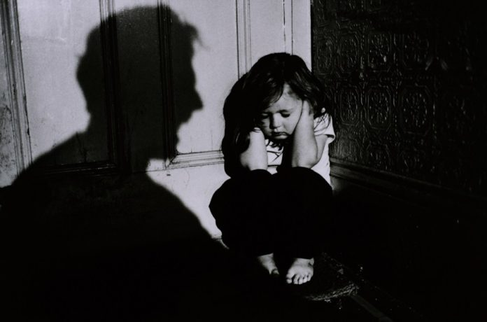

Background
Some reports also indicate that parents with ID often have experienced interpersonal trauma (IPT).
A well-established risk factor for caregiving-related problems among parents without ID (e.g., Greene et al., 2020; van IJzendoorn et al., 2020).
Possible that such experiences may contribute to the caregiving-related risks displayed by parents with ID.
Reports have, however, been inconsistent, both with regard to prevalence of IPT (cf. Granqvist et al., 2014; Hellfritz, 2018), and the role of IPT for caregiving and child developmental outcomes (cf. Lindberg et al., 2017; Tymchuk & Andron, 1990).
Synthesised knowledge not available…

Slide 5
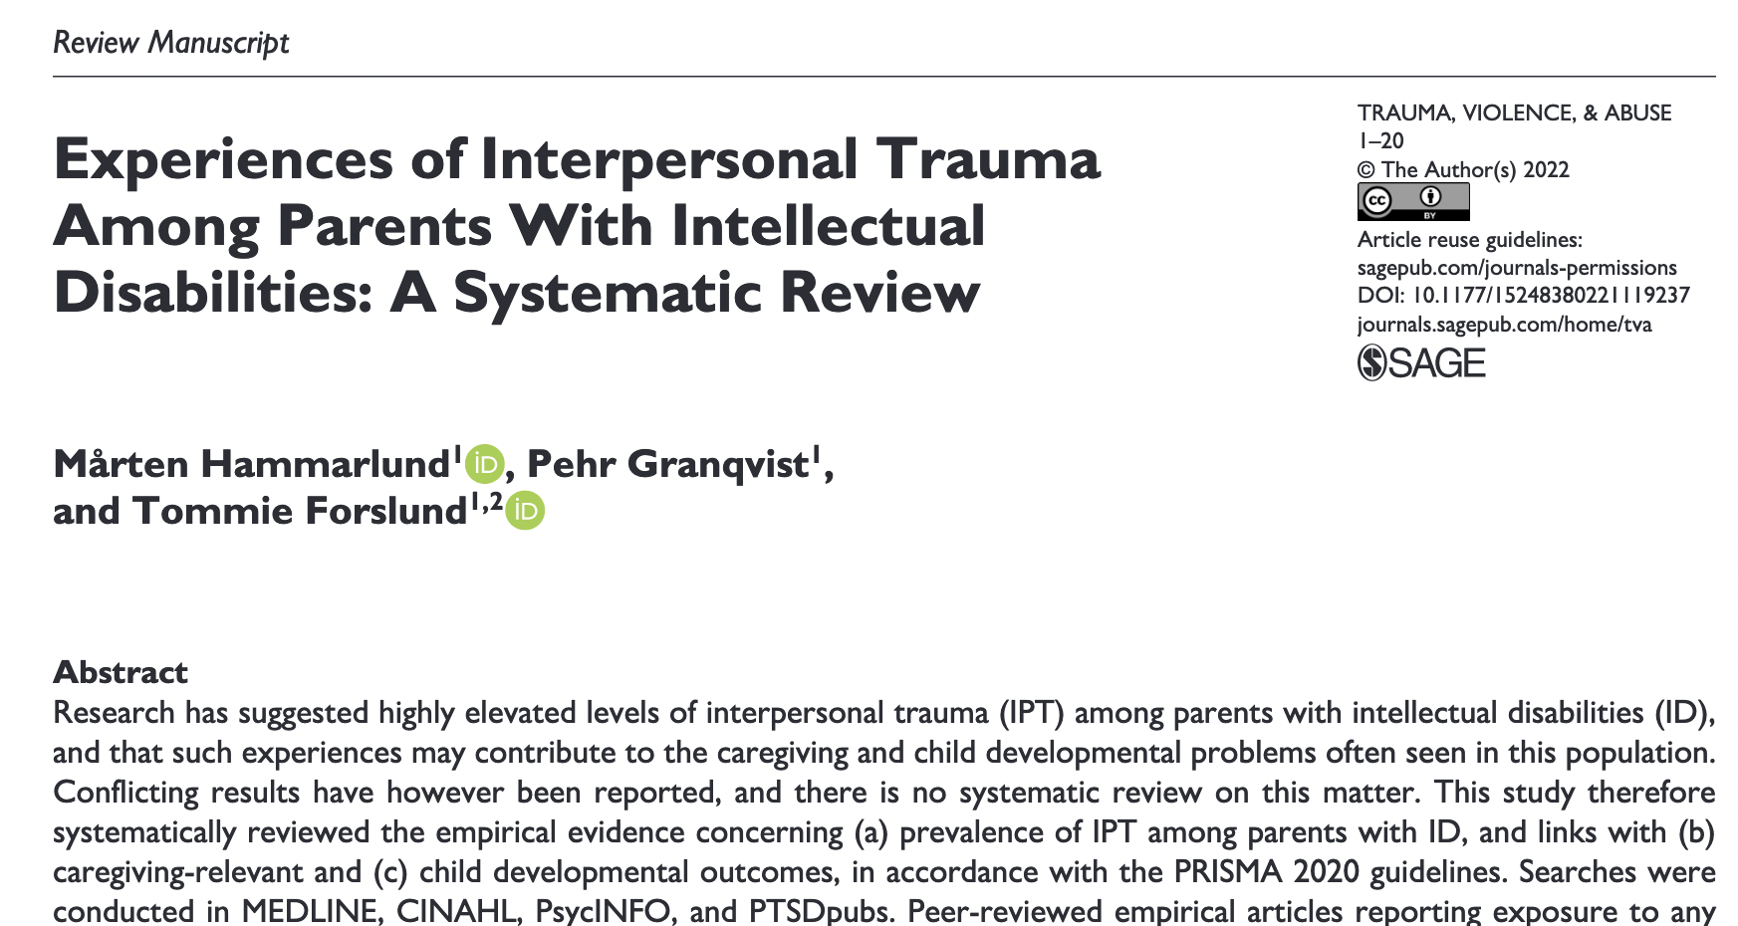
The Review
…so we set out to obtain such knowledge.
Aims:
To synthesise extant empirical evidence pertaining to:
  the prevalence of IPT (in unspecific as well as specific forms) among parents with ID, and the role of such experiences for
  caregiving-related outcomes and
  child developmental outcomes.

Slide 6
Method
Systematic searches in PsycINFO, MEDLINE, CINAHL and PTSDpubs + forward and manual searches.
Included: peer-reviewed empirical articles reporting on exposure to any type of IPT (unspecified IPT; physical, sexual, and emotional abuse; neglect; witnessing caregiver violence; prolonged childhood separations from caregivers), based on systematic assessments.
Studies pertaining to research question a) were required to be based on independent/unique samples.
20 studies (14 independent samples) met inclusion criteria.
Study quality was assessed with NIH quality assessment tools (NIH, 2013).

Slide 7

Results – prevalence of IPT
10 studies reported on experiences of unspecified IPT among the parents. Generally high rates, regardless of sample type:
  Clinical samples: 7 studies; range: 42%–91%; combined prevalence = 58% (n = 412); weighted median = 52%
  Court samples: 2 studies; range: 60%–75% (n = 1182)
  Community samples: 1 study; 42% (n = 168)
Weighted median across all independent samples ≈ 60%.
Rates are elevated even in comparison with population data from other groups at high risk for IPT (e.g., patients with severe psychopathology; Gatov et al., 2020).
Eugene Carriere (1899), ”Her mother’s kiss”

Slide 8
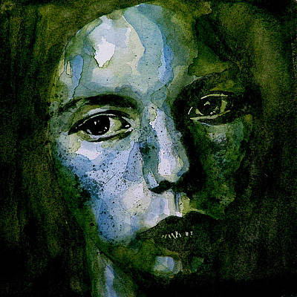
Results – prevalence
Specific types of IPT:
  Sexual abuse: 6 studies; range: 24%–58%; weighted median: 38%.
  Physical abuse: 5 studies; range: 31%–61%; weighted median: 50%
  Emotional abuse: 3 studies; range: 38%–54%.
  Neglect: 3 studies; range: 12%–35%.
  Prolonged separations from caregivers: 4 studies; range: 17%–36%.
  Witnessing caregiver violence: 1 study; 48%.
Even the lower estimates are typically higher than population-level estimates for comparable countries (cf. Moody et al., 2018; Stoltenborgh et al., 2013).
Experiences of prolonged separations, mainly in the form of OoHC, 4–10 times more common than in the general population.
Paul Lovering, ”Tell me there’s a heaven”

Slide 9

Results – caregiving-related outcomes
Mixed evidence with regard to caregiving-related outcomes, but findings overall converge on IPT as a risk factor for caregiving-related problems:
Consistent links with parental psychiatric/mental health problems (4 studies).
Overarching support for parental IPT as a risk factor for severe caregiving difficulties, as indicated by child welfare involvement/OoH placement of child (5 studies).
Inconsistent findings with regard to links with self-reported parenting attitudes and -behaviours (Note: Methodologically dubious).
Consistent links with observed caregiving-related difficulties (Note: Only 2 studies; both from the same sample).
Jackson Pollock (1952), ”Convergence”

Slide 10

Results – child developmental outcomes
Very few studies—and mixed findings—pertaining to child developmental outcomes:
1 large court-based study found that parental IPT predicted child learning problems and developmental delays (regression model did, however, display poor fit with data).
1 study found that parental IPT was linked with lower child attachment security, and higher attachment disorganisation.
2 studies found no link between parental IPT and child developmental outcomes (motor and cognitive development; social skills).
Jackson Pollock (1953), ”The Deep/Profound Void”

Slide 11

Important limitations
Marked inconsistency with regard to assessments of IPT. Most studies used incomprehensive assessments, with corresponding risk for under-detection (Glaesmer, 2016). Studies employing more rigorous assessments typically found higher prevalence.
Few studies involved fathers, and the role of paternal IPT in this context is thus unclear.
Only 25% of the included studies addressed cumulative or multi-type IPT. Highly problematic, because research on the general parent population indicates that the most relevant variation lies in the degree of exposure (rather than in sheer exposure vs. non-exposure; e.g., Bartlett et al., 2017; Khoury et al., 2021; Moog et al., 2023; VanBronkhorst et al., 2023).

Slide 12
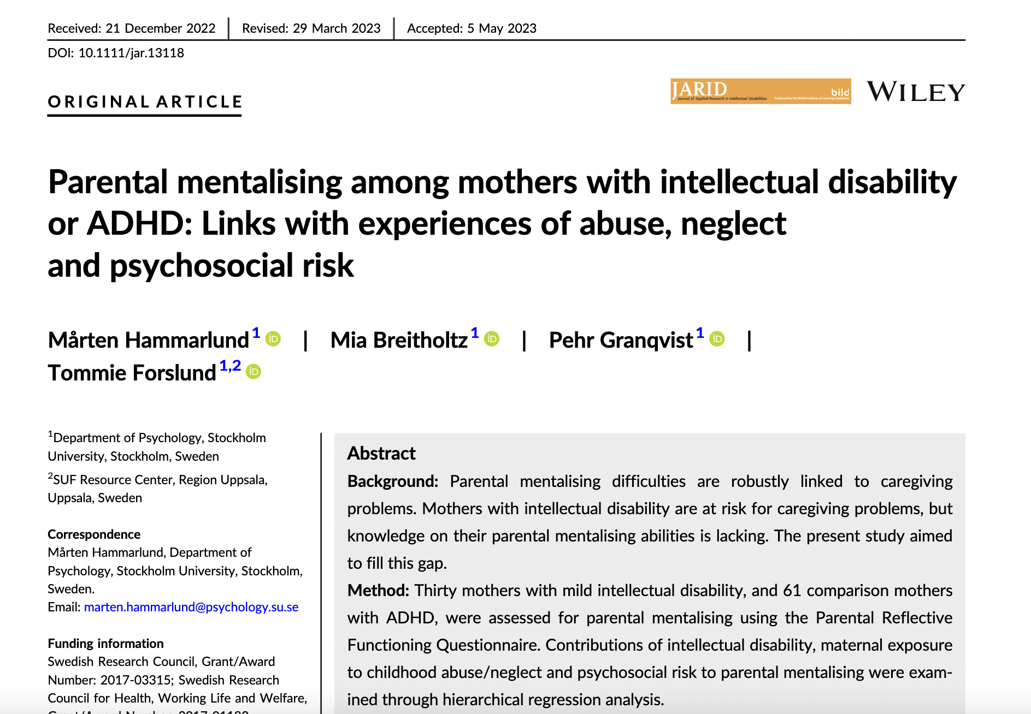
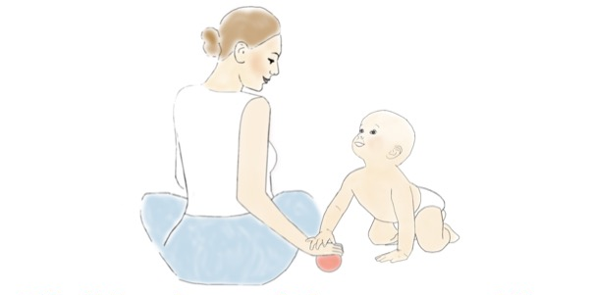
Adding to the picture…
Following the publication of the systematic review, we have also published a study addressing the role of cumulative IPT and psychosocial adversity (PA) for predicting parental mentalising difficulties among mothers with ID (n = 30), and comparison mothers with ADHD (n = 61).
Comprehensive assessment of a complete range of IPT types; conservative blind-coding of exposure.
Mothers with ID had a heightened risk for parental mentalising difficulties, but about 30% of the mothers had normative scores.
In hierarchical regression analysis, maternal ID was predictive of mentalising difficulties.
Accounting for cumulative IPT and PA among the mothers did, however, add considerable explanatory power to the model, while also markedly reducing the explanatory value of ID per se.
Parenting and child development
in families of parents with intellectual
disability (ID) or ADHD

Slide 13

Take-home messages
Findings indicate that:
  At least 50% of parents with ID have been exposed to some type of IPT.
  Parental IPT—and especially high cumulative exposure—increases the risk for caregiving-related problems among the parents.
  The substantial variation in caregiving-related outcomes among the parents indicate that a diagnosis of ID per se is of limited value for understanding caregiving-related problems in this population.
Support services should screen for IPT experiences among parents with ID, using comprehensive instruments, and focusing especially on severe/repeated exposure.
Professionals supporting parents with ID should ascertain appropriate training in trauma-informed care.
Professionals should also ascertain training to recognize marked post-traumatic symptoms, and—when warranted—help parents to seek out psychotherapeutic interventions (EMDR, CBT).

Slide 14

Thank you for listening!
marten.hammarlund@psychology.su.se

