Slide 1
The psychosocial and wellbeing needs of secure mental healthcare staff accessing trauma support
Elanor Lucy Webb & Dr Annette Greenwood
Centre for Developmental and Complex Trauma, St Andrew’s Healthcare | Faculty of Medicine and Health Sciences, University of Buckingham | Trauma Response Service, St Andrew’s Healthcare

Slide 2
Staff in secure mental health settings are frequently exposed to service user distress and aggression, in addition to other potentially traumatic events (e.g., restrictive practices)
PTSD prevalence rates in secure MH staff are 5x higher than those reported in the general population, and 2x higher than those reported in non-forensic mental healthcare settings
Exposure to trauma and the resulting adverse psychosocial outcomes are associated with workplace absenteeism and intention to leave healthcare (Liu et al., 2018), highlighting the importance of providing effective staff support
In recognition of the challenges and needs of this occupational group, trauma support services for staff have proliferated, though in the absence of any robust or comprehensive evaluation of needs and outcomes.
Critically, an understanding do (and don’t) access the service, the events that precipitate referral, and the psychosocial needs of staff accessing support is key.
Such information is critical to informing the implementation of effective service structures, interventions and prevention strategies that minimise exposure to traumatic incidents and their impacts
Background

Slide 3
Research questions
Who accesses the trauma support service and for what incidents?
What are the wellbeing needs of staff accessing the service?
What factors are associated with higher levels of distress in referrals?
Setting & design
Method
Evaluation of cross-sectional data collected within a staff trauma support service within a secure mental health organisation.
Support was provided by three consultant psychologists and a consultant psychotherapist, including 1:1 and group sessions, debriefs, EMDR, CBT and compassion-focused interventions.
Participants
Data was analysed for staff referred to the service between November 2020 and December 2021.
Staff were mostly female (66%), of a white ethnicity (43.5%), with a median age of 41 years.
Most were working in a nursing profession (81.5%) in registered (30.5%) or unregistered (54.5%) roles.
Procedure
Data pertaining to the type and location of incidents, as well as post-incident medical support and absenteeism was extracted. Additionally, scores on Likert scales (0-6) assessing anxiety, depression and psychological trauma were extracted and summed to create a ‘global index severity’ (GSI) score.
Notes:
Physical incidents were defined as those with the potential to cause bodily harm including physical and sexual assaults.
Incidents categorized as psychological
occurred without physical contact, and included verbal
threats, ‘hate’ language, and racially motivated insults.
The death of service users, colleagues or family mem?bers were also categorized as psychological incidents.

Slide 4
Who accessed the service?
154 staff
(4.6%) accessed the service in the year
The service was accessed by clinical (92%) and non-clinical (8%) staff
28% of referrals did not have a social support network outside of the workplace
What did staff access the service for?
Key results
58%
42%
psychological incidents
physical incidents
29%
71%
100%
non-work events
work-based events
work-based events
Bereavement related incidents
E.g., verbal threats, service user deaths
E.g., physical assault

Slide 5
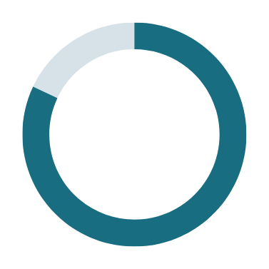
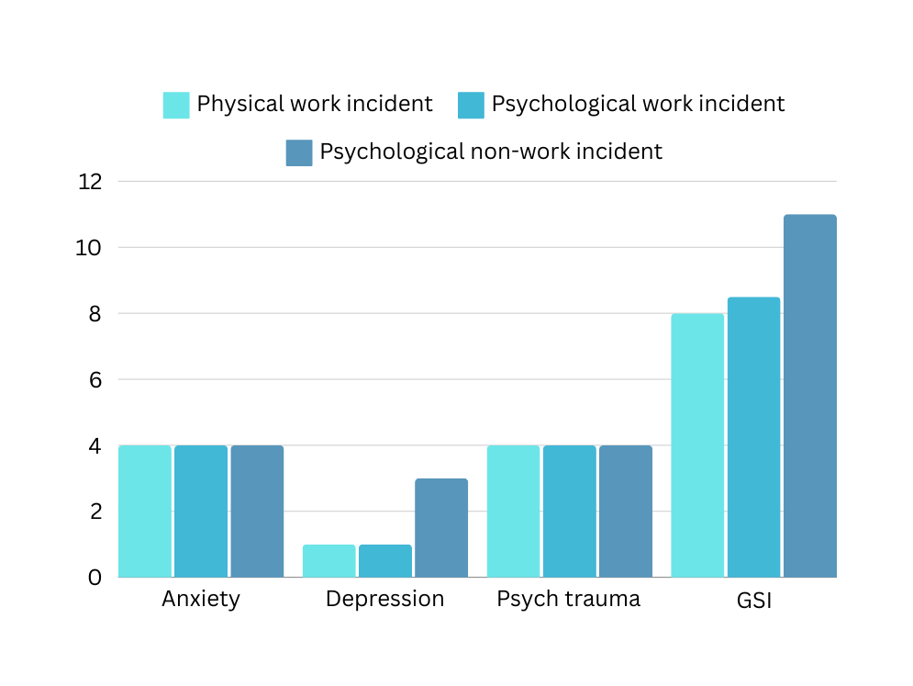
Wellbeing and functioning profiles of referrals
82%
reported sleep changes
Key results
66%
reported socialising changes
Suicidal ideation was reported by...
6.2% of staff accessing support for a physical work trauma
19.0% of staff accessing support for a psychological work trauma
34.6% of staff accessing support for a psychological non-work trauma

Slide 6
Factors associated with higher distress
Social support
Staff without SS were 2x as likely to report suicidal thoughts.
Non-significant trends also observed for greater anxiety, depression and GSI, and changes to socialising habits
Key results
Type and location of traumatic incident
Psychological incident = 5x more likely to report suicidal thoughts
Non-work psychological incident = higher depression and GSI scores
Post-incident medical support and absenteeism
Physical work incident: A&E attendance and absenteeism = higher psychological trauma symptoms and GSI scores, respectively
Work-based psychological incident: GP attendance = higher GSI; Absenteeism = higher anxiety, depression and GSI
Home-based psychological incident: No significant associations for GP attendance nor absenteeism with wellbeing outcomes

Slide 7
Service provision
In consideration of the ongoing exposure to trauma in secure MH settings, challenges in accessing statutory MH services, and the brief nature of EAPs, organisations have a responsibility for the provision of more comprehensive support.
Services that support both clinical and non-clinical staff for a range of traumatic experiences occurring within and outside of the workplace are key
Attending to psychological traumas
Conclusions & Implications
The distress of staff working in healthcare is not confined to work-based experiences.
Staff accessing support for psychological incidents had the highest levels of depression and overall distress, and risk for suicidal thoughts, though were least likely to be absent from the workplace.
The impacts of psychological incidents may therefore not be as readily observable.
Bolstering social support
Staff without social support were over-represented in referrals to the service, when compared to rates reported across the organisation (28% vs. 13.5%).
Interventions that improve social support access within the workforce (e.g., social skills training, community engagement programmes) should be implemented and evaluated.

Slide 8
Thank you for listening
Full paper:
Morris, D. J., Webb, E. L., Worsfold, J., & Greenwood, A. (2023). Exploring the psychosocial and wellbeing needs of staff accessing trauma support in forensic mental health services in the UK: Relations with demographic, occupational and trauma event characteristics. International Journal of Forensic Mental Health. https://doi.org/10.1080/14999013.2023.2183530
CDCT@stah.org
agreenwood@stah.org

