Slide 1
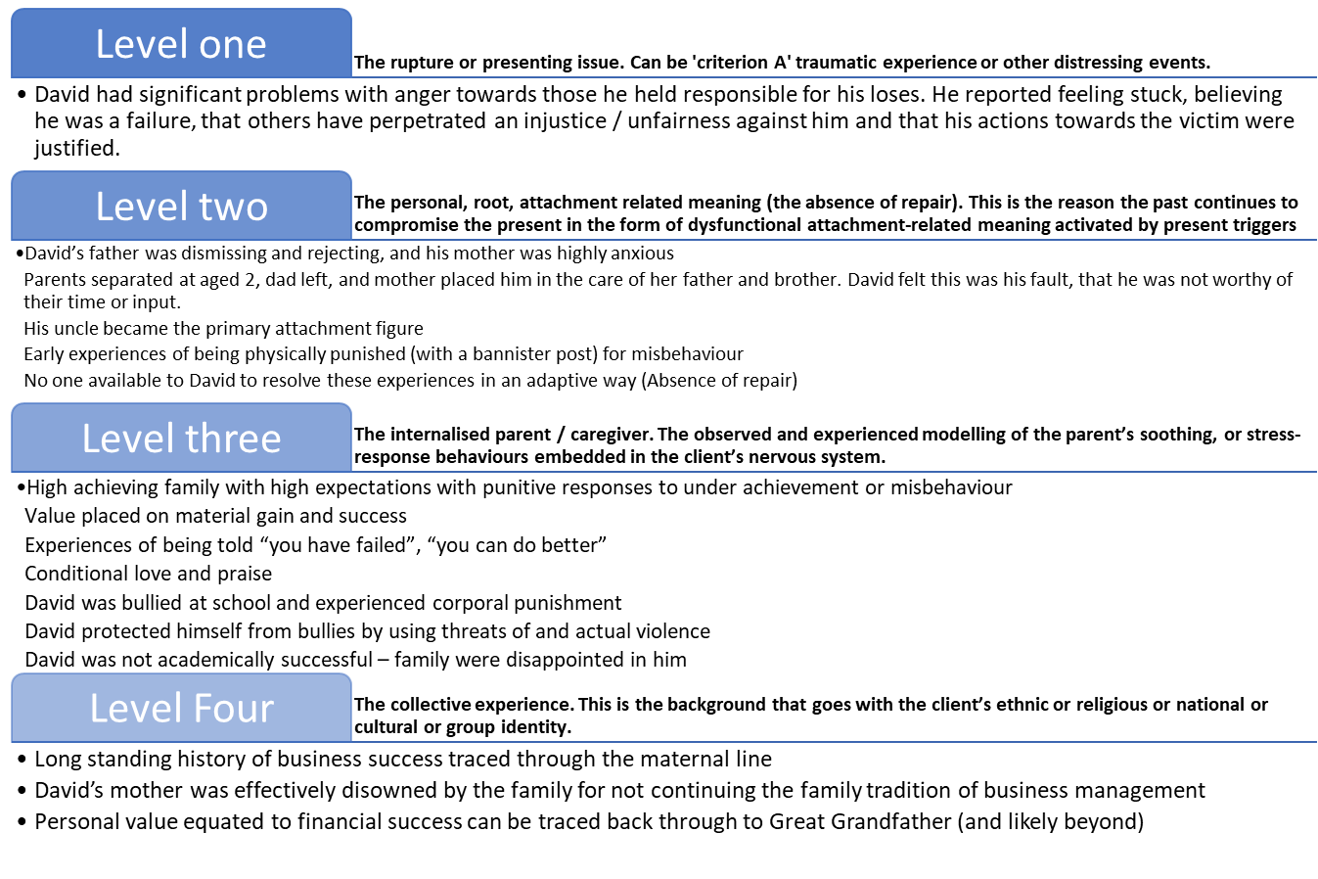
Uncovering the traumatic roots of Delusional Disorder. A case study using Attachment-Informed Eye Movement Desensitisation and Reprocessing (AI-EMDR) in a forensic patient. Dr Karine Greenacre (Consultant Forensic Psychologist), Dr Trevor Broughton (Consultant Forensic Psychiatrist), & Beth Palmer (Trainee Clinical Psychologist).
Delusional disorder is characterized by at least 1 month of delusions but no other psychotic symptoms (DSM-5-TR).
Background
People with mental illness experience trauma at a higher rate than the general population (Spidel et al., 2010).
Research shows links between individuals with trauma histories and violent behaviour; there is a higher prevalence of trauma within forensic populations (McKenna et al., 2019).
Trauma symptoms overlap with other presentations such as personality disorder and schizophrenic disorders (Miller, 2016; van der Hart et al., 2006).
Delusional disorder (DD) is considered resistant to treatment. There are no specifically licenced pharmacological treatments for DD (Munoz-Negro et al., 2016) and no definitive treatment guidance (Skelton et al., 2015).
Evidence suggests that psychosis occurs in people with trauma histories and findings suggest that EMDR can be beneficial for people with psychosis (Adams et al., 2020) including targeting negative beliefs.
Introducing David
Short-term admissions with medication titration, fast discharge, then lost to follow up
Paranoid and persecutory beliefs
Hostile and aggressive to staff
History of harassment of former colleagues, with one primary victim
Offence against the primary victim of assault using a pick-axe
Sectioned under 37/41 and detained in secure services
Diagnosed with Persistent Delusional Disorder
David rejected his diagnosis and was opposed to medication
Cognitive Behaviour Therapy and schema therapy were unsuccessful
Attachment-Informed Case Conceptualisation (Brayne 2022)
Reappraisal of beliefs
Method
One AI-EMDR session per week with psychologist.
OT developed an alternate occupational identity.
David was prescribed Aripiprazole.
Staff used validation and empathy. They did not disagree with him or tell him his beliefs were wrong or delusional.
David’s Psychiatrist investigated his claims, finding some basis in fact.
References
Adams, R., Ohlsen S., & Wood, E. (2020). Eye Movement Desensitization and Reprocessing (EMDR) for the treatment of psychosis: A systematic review, European Journal of Psychotraumatology, 11(1).
American Psychiatric Association. (2013). Diagnostic and statistical manual of mental disorders (5th ed.)
Brayne, M. (2022). Unleash your EMDR, UK: EMDR Focus.
McKenna G, Jackson N, Browne C. (2019). Trauma history in a high secure male forensic inpatient population. Int J Law Psychiatry, 66.
Miller, P. W. (2016). Therapy for schizophrenia and other psychoses. NY: Springer Publishing Company, LLC.
Muñoz-Negro, J. E., Cervilla, J. A. (2016). A Systematic Review on the Pharmacological Treatment of Delusional Disorder. Journal of Clinical Psychopharmacology 36(6): pp 684-690.
Skelton M, Khokhar WA, Thacker SP. (2015). Treatments for delusional disorder. Cochrane Database Syst Rev
Spidel A, Lecomte T, Greaves C, Sahlstrom K, Yuille JC. (2010). Early psychosis and aggression: predictors and prevalence of violent behaviour amongst individuals with early onset psychosis. Int J Law Psychiatry, 33(3):171-6.
Van der Hart, O., Nijenhuis, E. R. S., and Steele, K. (2006). The Haunted Self. Structural Dissociation and the Treatment of Chronic Traumatization. NY: Norton.
Qualitative Themes
Journey of Detention
Conditions for successful EMDR
Therapeutic Processes
Meaningful outcomes
Discussion Points
Collaborative formulation with the SU is crucial
Reformulation of psychotic illness from a trauma-perspective facilitated therapy and engagement
Importance of using different interventions to achieve health outcomes
EMDR appears effective with DD, offering wider opportunities for treatment/ David was conditionally discharged and continues to engage in the community
Quantitative results
 | Pre | Post | Reliable Change Indicator | Clinically Significant Change
PCL-5 | 27/80 | 3/80 | Improved | Yes
PSYRATs (DS) | 19/24 | 7/24 | Improved | N/A

